Slide 1
Digital Twins state-of-the-art, use cases, and new trends
Carlos Canal – ITIS Software, University of Málaga
Sergio Laso – Quercus SEG, University of Extremadura
SummerSOC 2025
Hersonissos (Crete), June 16th - 21th, 2025

Slide 2
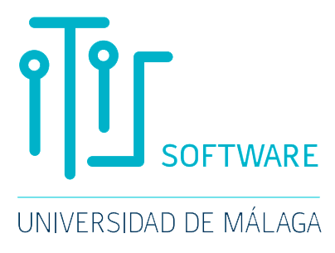

Digital Twins Part I
Carlos Canal – ITIS Software, University of Málaga
(carloscanal@uma.es)

Slide 3
Contents
QR
PDF
Introduction
The Hype of Digital Twins
What is a Digital Twin?

Slide 4
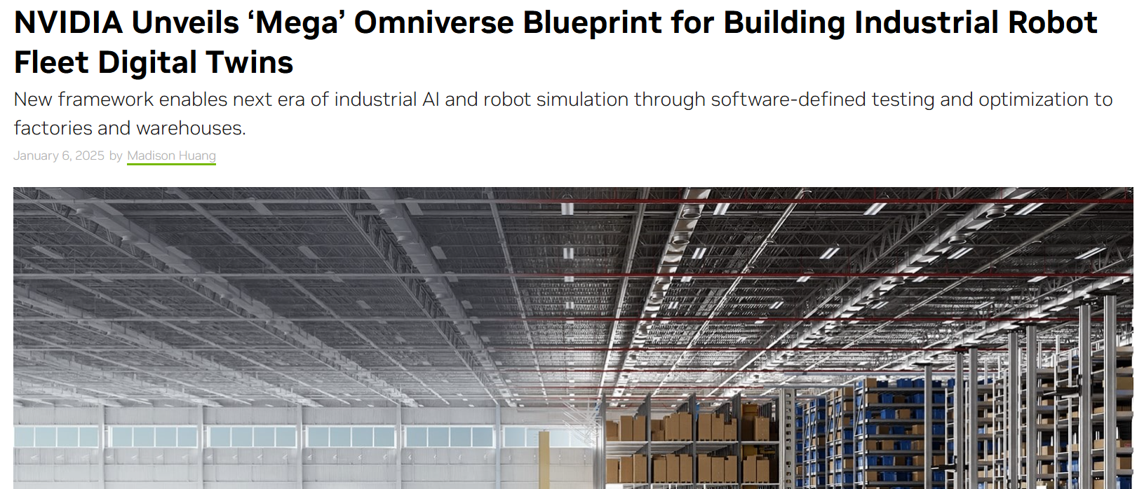
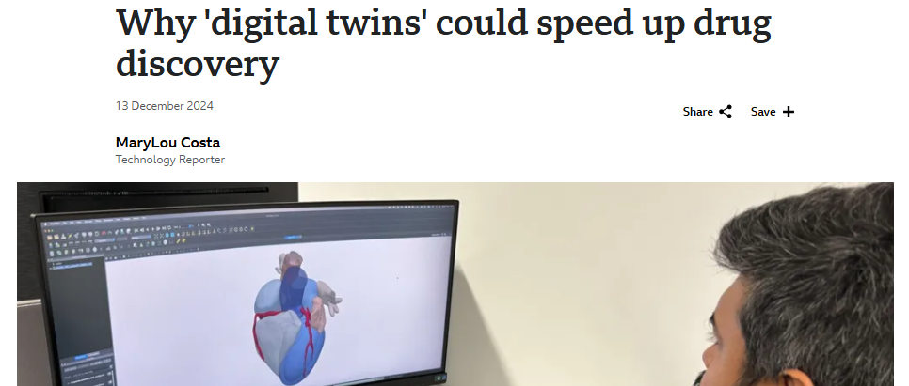
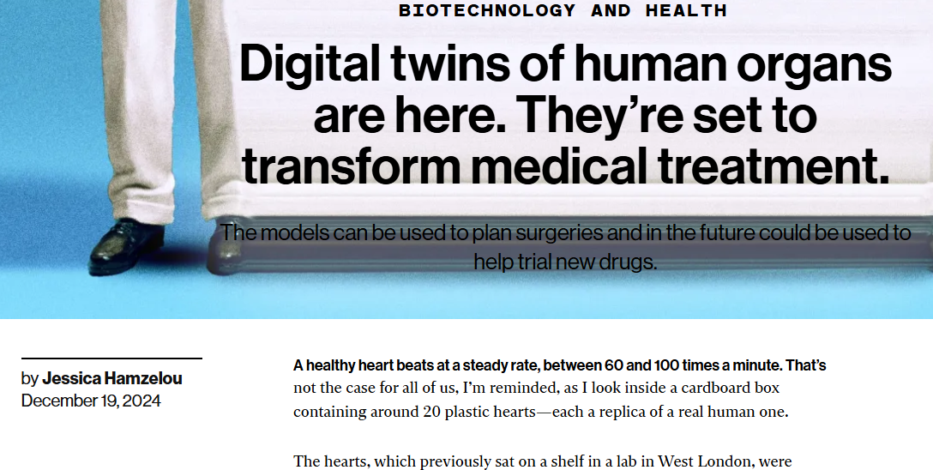
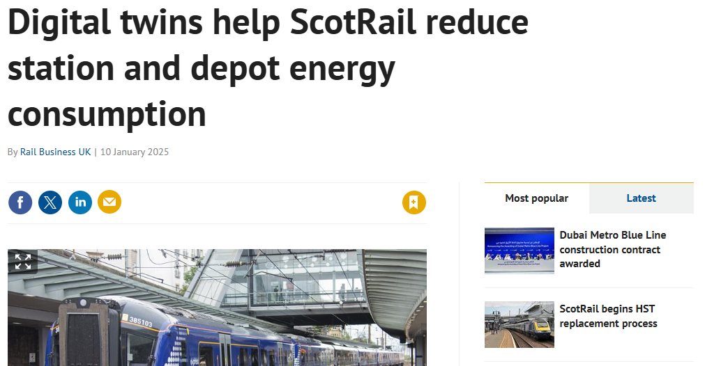
The Hype – News

Slide 5
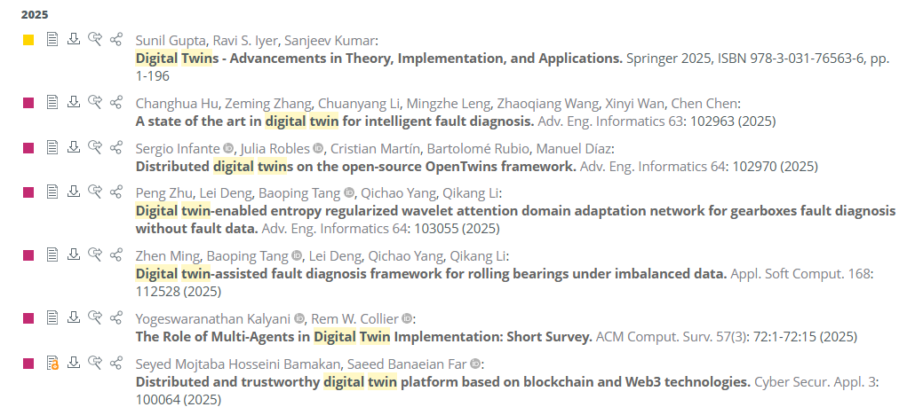
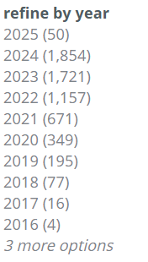
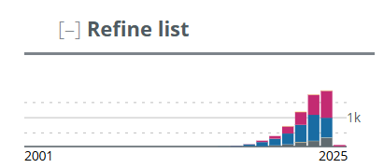
The Hype – Research works in DBLP
A
B

Slide 6
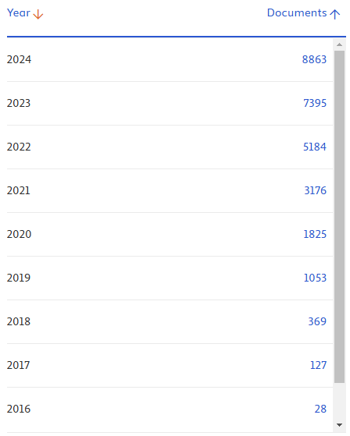
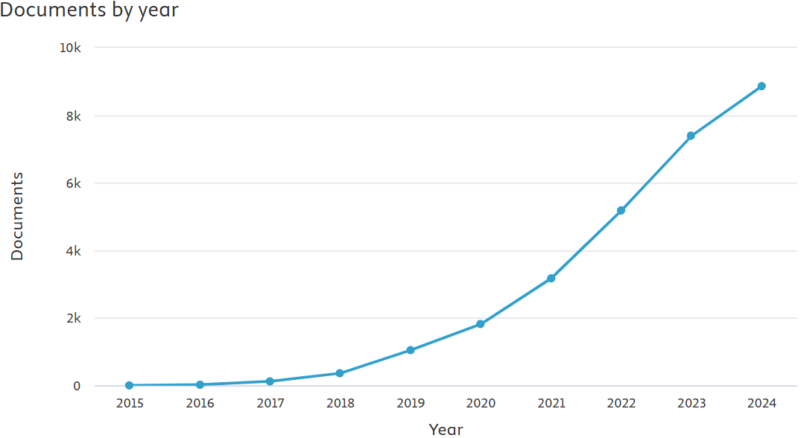
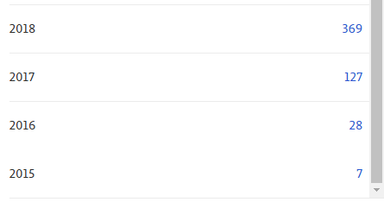
The Hype – Research works in SCOPUS

Slide 7
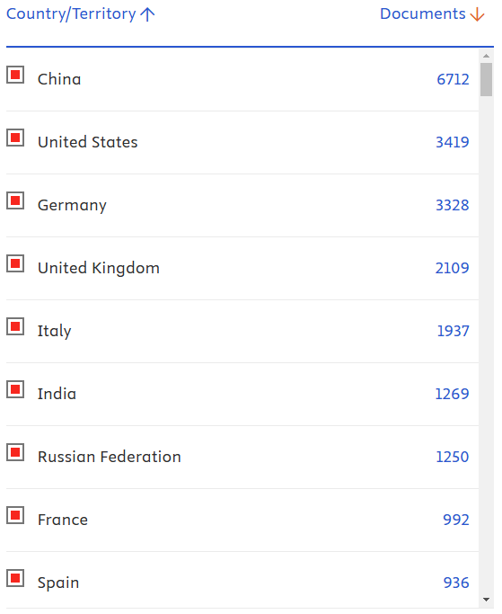
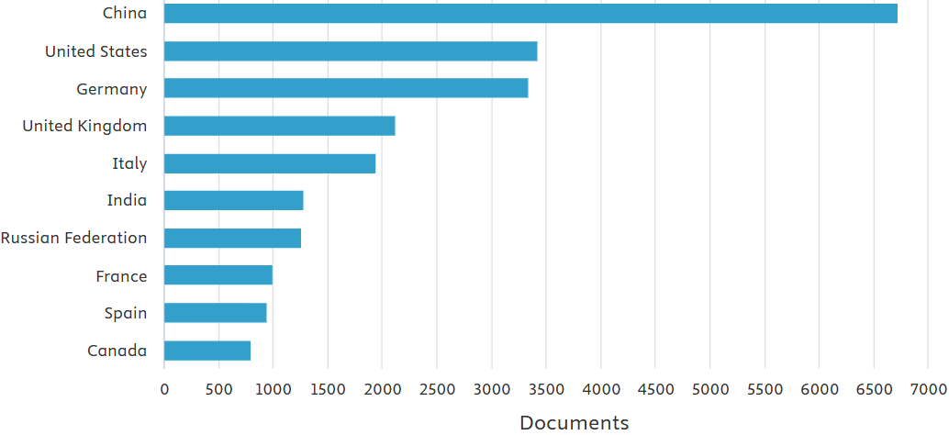
The Hype – By country

Slide 8
Definition / Concept
What is a Digital Twin?
What are its main components
its main features
and its required components?
Let’s ask someone informed…

Slide 9

An answer – ChatGPT
Good morning, what is a digital twin?
Gemini, Copilot, DeepSeek, and Wikipedia provide very similar answers.
Good morning! A digital twin is a virtual representation of a physical object, system, or process that is continuously updated with real-time data. It mirrors the physical counterpart as accurately as possible and is used to monitor performance, predict outcomes, and support decision-making.
Key features of a digital twin:
Real-time data: It uses sensors or other data sources to stay in sync with the physical version.
Simulation: It can simulate different scenarios to predict how changes will affect performance or behavior.
Analytics: Uses AI and machine learning to analyze data and generate insights.
Lifecycle integration: It can track the full lifecycle of a product—from design to operation and maintenance.

Slide 10
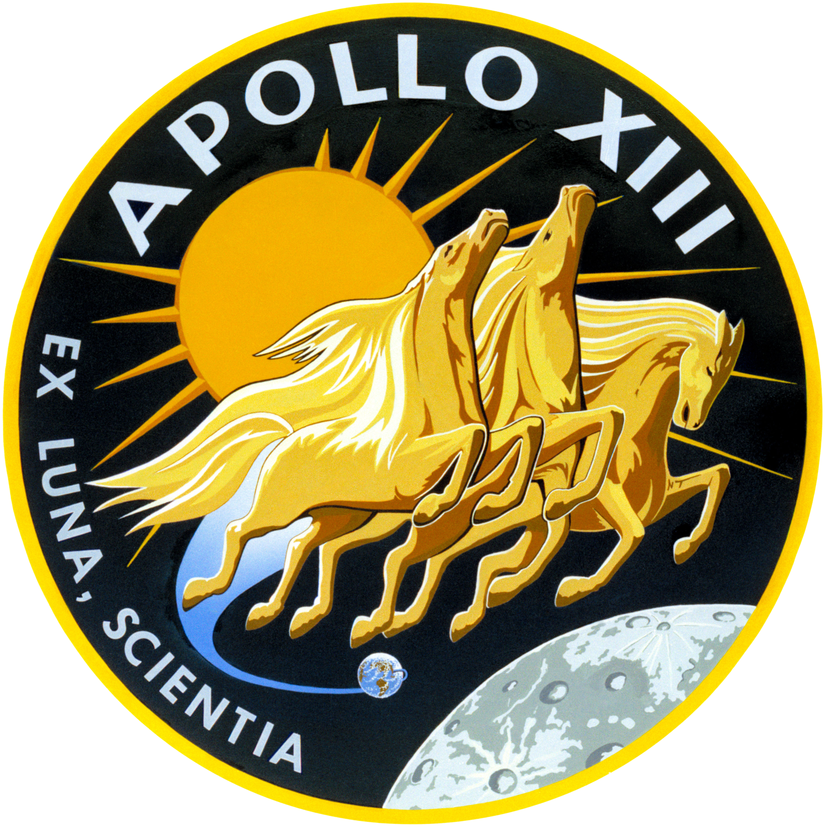
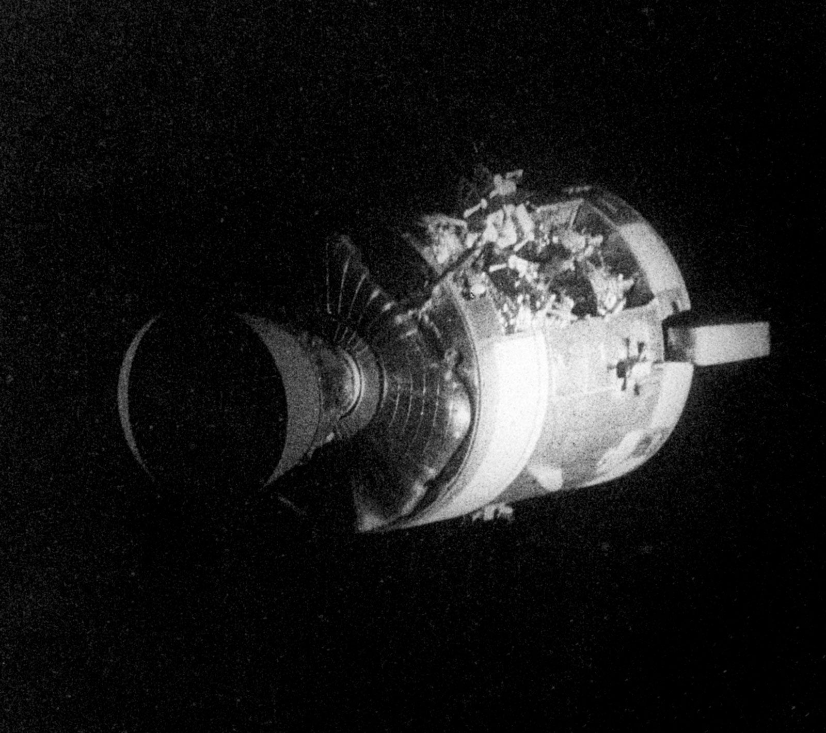
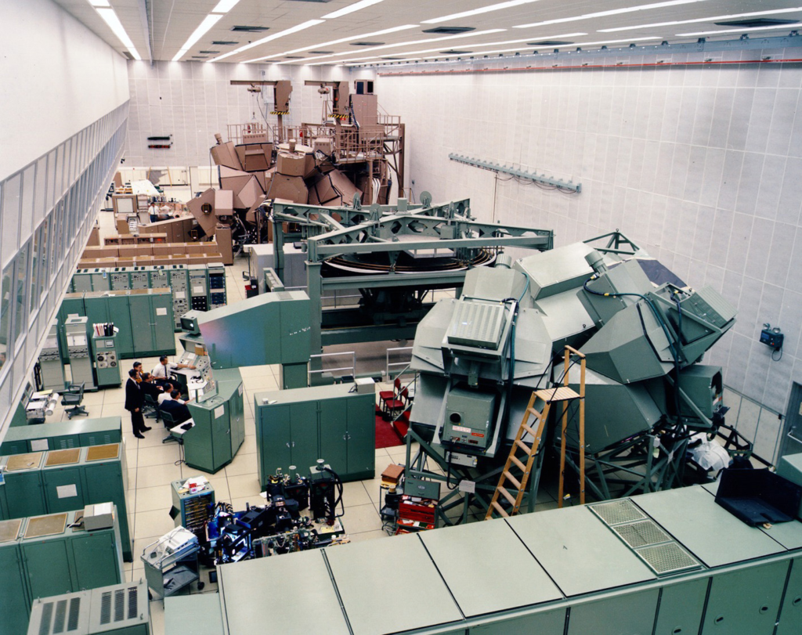

A brief history of Digital Twins
The Apollo 13 Mission (1970)
The Apollo 13 Its “Digital Twin” on Earth
https://blogs.sw.siemens.com/simcenter/apollo-13-the-first-digital-twin

Slide 11
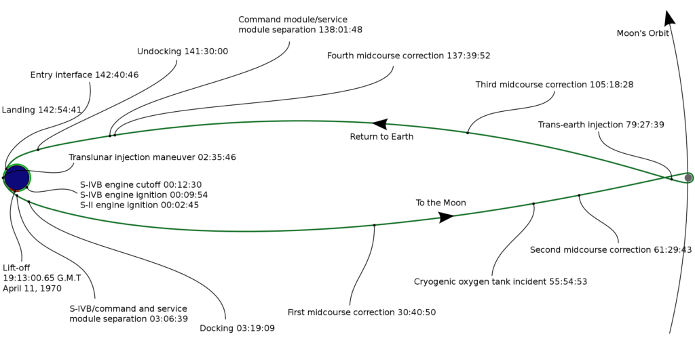
The Apollo 13 Mission
The incident

Slide 12


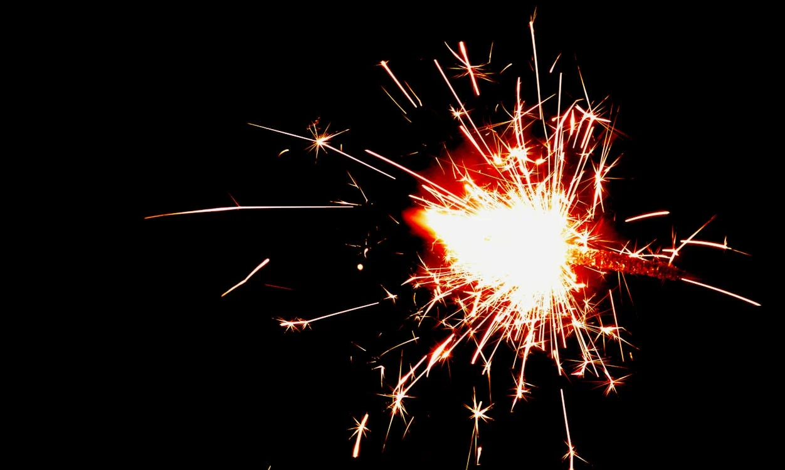



The Apollo 13 Mission
The very first twins?
but synchronization was performed manually.
Manual sync

Slide 13

First definitions of a Digital Twin
The concept was first established by M. Grieves:
within a course on Product Lyfecycle Management in the Univ. of Michigan (2003)
though instead of DT, he used the term Mirrored Spaces Model 😏
The first definition comes from M. Shafto et al:
A digital twin is an integrated multi-physics, multi-scale, probabilistic simulation of a vehicle or system that uses the best available physical models, sensor updates, fleet history, etc., to mirror the life of its flying twin.
Modeling, Simulation, Information Technology & Processing Roadmap National Aeronautics and Space Administration (2012)
A more general definition appeared in a later paper by M. Grieves:
A digital twin is a virtual representation of what has been produced.
Digital Twin: Manufacturing excellence through virtual factory replication Florida Institute of Technology, White Paper (2014)

Slide 14
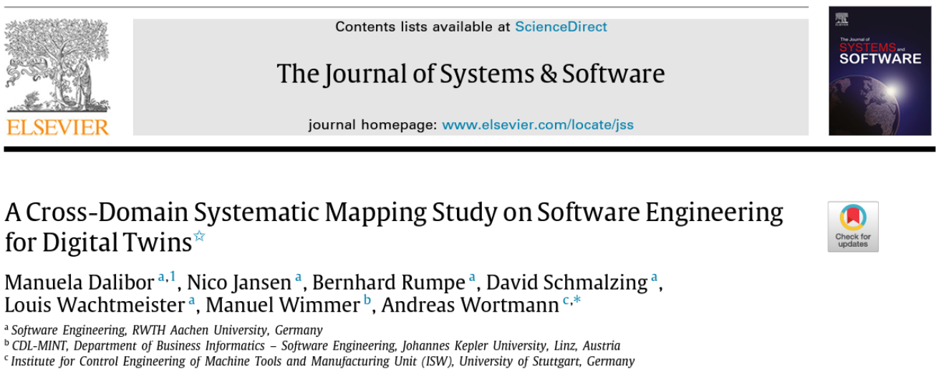
… but there are many more
Companion website
356 papers
reviewed
112 definitions
of the term
“Digital twin”
Dalibor et al. “A Cross-Domain Systematic Mapping Study on Software Engineering for Digital Twins”, The Journal of Systems and Software, vol. 193, 2022.

Slide 15
Several of these definitions
Some of them are too vague:
Digital equivalent to a physical product.
Simulation method that can be used for evaluation and optimization.
Model-based representation of entities of the real world such as machines, cars, or persons.
Simplified numerical model.
Some of them are specific of a certain domain:
Virtual replica of the printing hardware.
Set of virtual information that fully describes a potential or actual physical production from the micro atomic level to the macro geometrical level.
Virtual model of the physical plant.
Software model composed of 3D physical, mechanical, and electrical data along with detailed information about its assembly process and instructions on production.

Slide 16

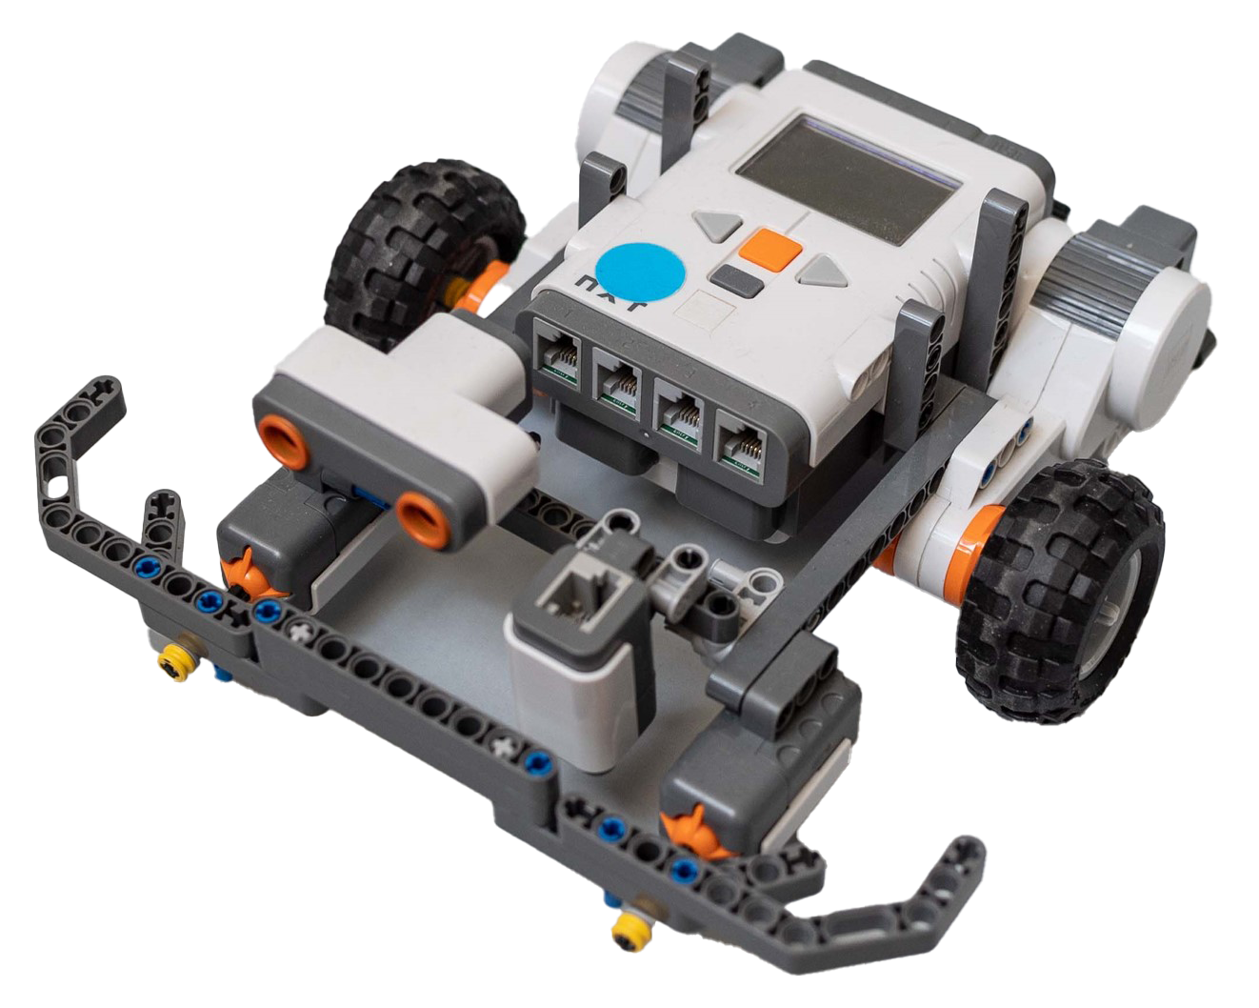
Definition of the DT Consortium
A digital twin is an integrated data-driven virtual representation of real-world entities and processes, with synchronized interaction at a specified frequency and fidelity.
Digital Twin Consortium, Glossary of digital twins (2021)
Physical Twin
Physical Twin
Digital Twin
Bidirectional Synchronization

Slide 17
To sum up
fill the gap
A Digital Twin is either a of its physical (PT) counterpart?
model
simulator
dashboard
control loop
prediction system
machine learning (ML) system
Yes (to all) but:
the physical twin could be any physical entity, but also a process, a software system, etc.
there is a synchronous and automated feedback loop communication between both twins.
A Digital Twin System is a pair of coupled physical/digital twins.
Entrar en cada una de ellas, preguntandoles (hacer varias diapos si da tiempo).
Ver notas en Contents. La segunda parte de la diapo, luego

Slide 18
Properties of Digital Twin Systems
Representativeness & Contextualization
the DT must mimic the status of the PT, considering only the features that are relevant to the context.
Reflection
the PT is timely and univocally represented by the attributes, status, and behavior of its DT.
Entanglement
the information representing the PT must be received in (close to) real-time by the DT.
Predictability
the DT may be used to simulate the behaviour of the PT to determine the outcomes in a likely future or context.
E. Pretel, A. Moya, E. Navarro, V. López-Jaquero, P. González. Analysing the synergies between Multi-agent Systems and Digital Twins: A systematic literature review, Information and Software Technology, vol. 174, 2024.

Slide 19
Properties of Digital Twin Systems (2)
Persistency
the DT maintains a continuously updated and accurate virtual representation of the PT over time.
Memorization
the DT must store all meaningful past and present data and the context in which they originatyed originated for later analysis.
Replication
DTs may replicate the PT in different contexts, each replica addressing specific characteristics
Composability
DTs can be composed so that both the individual and composed objects can be observed and controlled.
Manageability
the DT enhances the PT by an API that facilitates its management, which also allows to deal with damages or problems of both PT/DT.

Slide 20
Architecture of a Digital Twin System
3D architecture
Synchronization mechanisms
Physical Twin
Digital Twin
M. Grieves, “Digital twin: Manufacturing excellence through virtual factory replication,” White paper, 2014.

Slide 21
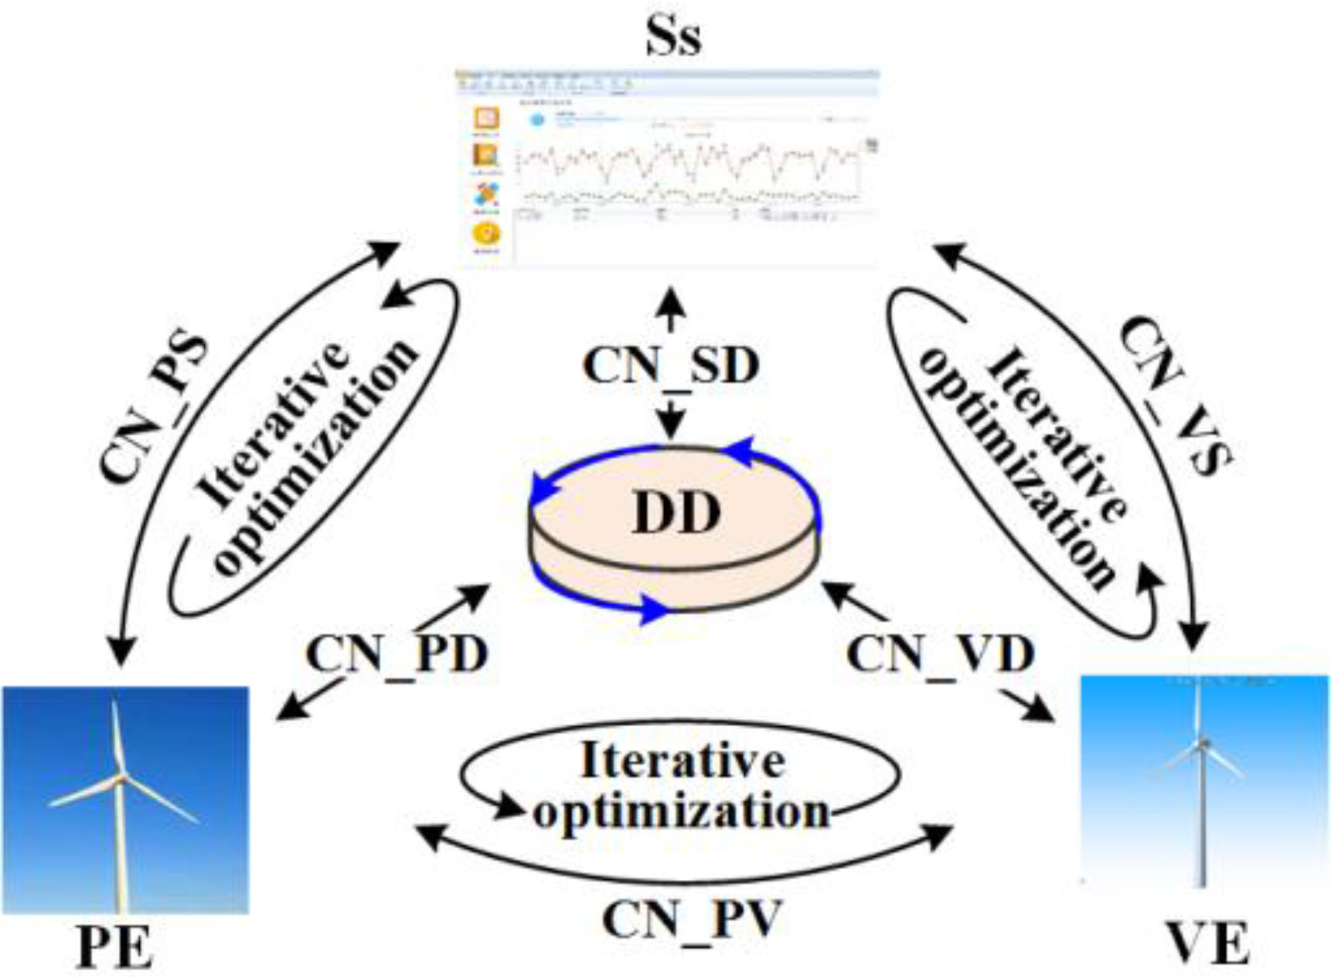
Architecture of a Digital Twin System
5D architecture
Physical Entity (PE)
Virtual Entity (VE)
Data lake (DD)
Services (Ss)
• User dashboard
• Data analysis
• Anomaly detection
• Predictive maintenance
• …
Tao, M. Zhang, Y. Liu, N.Y.C. Nee, “Digital twin driven prognostics and health management for complex equipment,” CIRP Annals, vol. 67, no. 1, pp. 169–172, May. 2018.

Slide 22
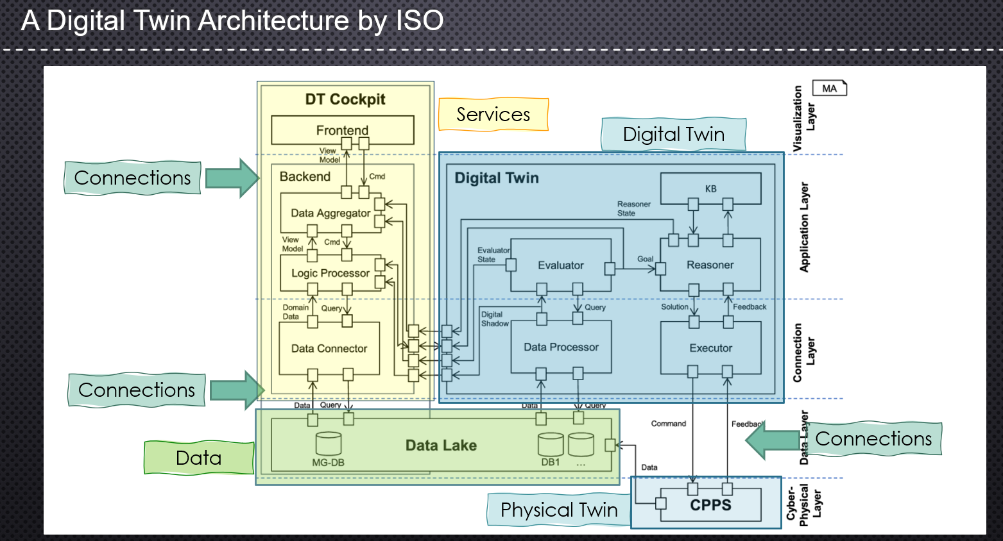
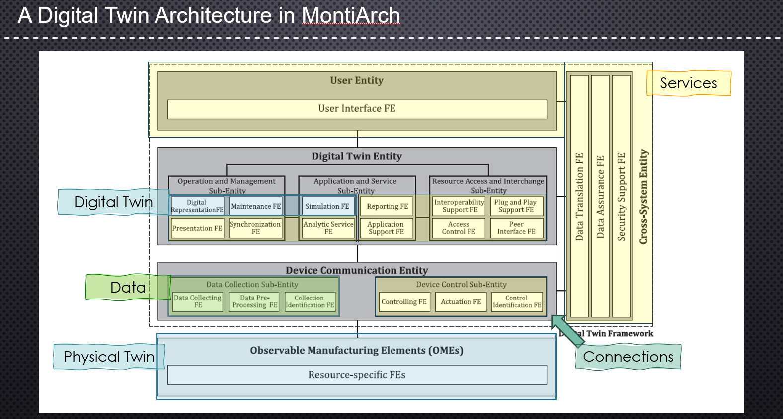
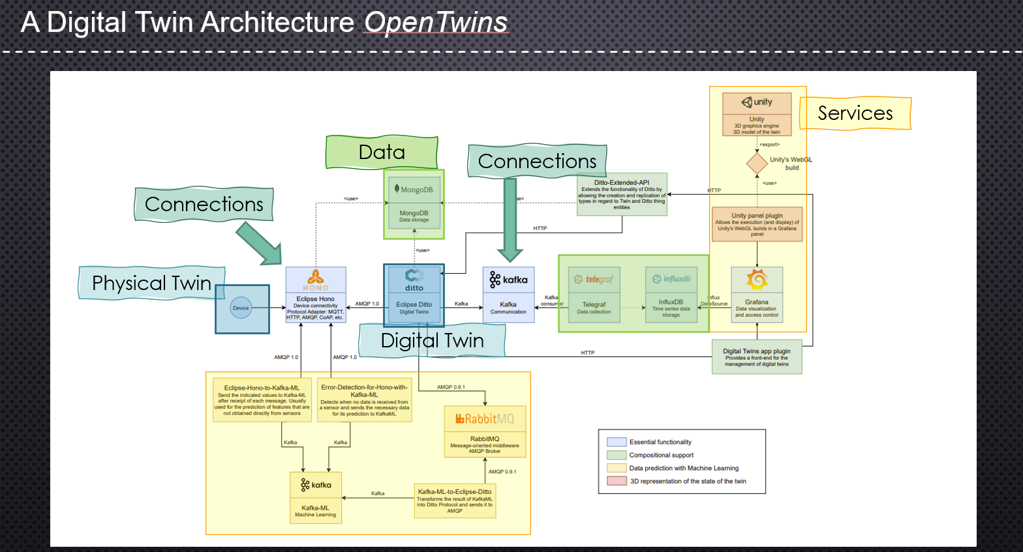
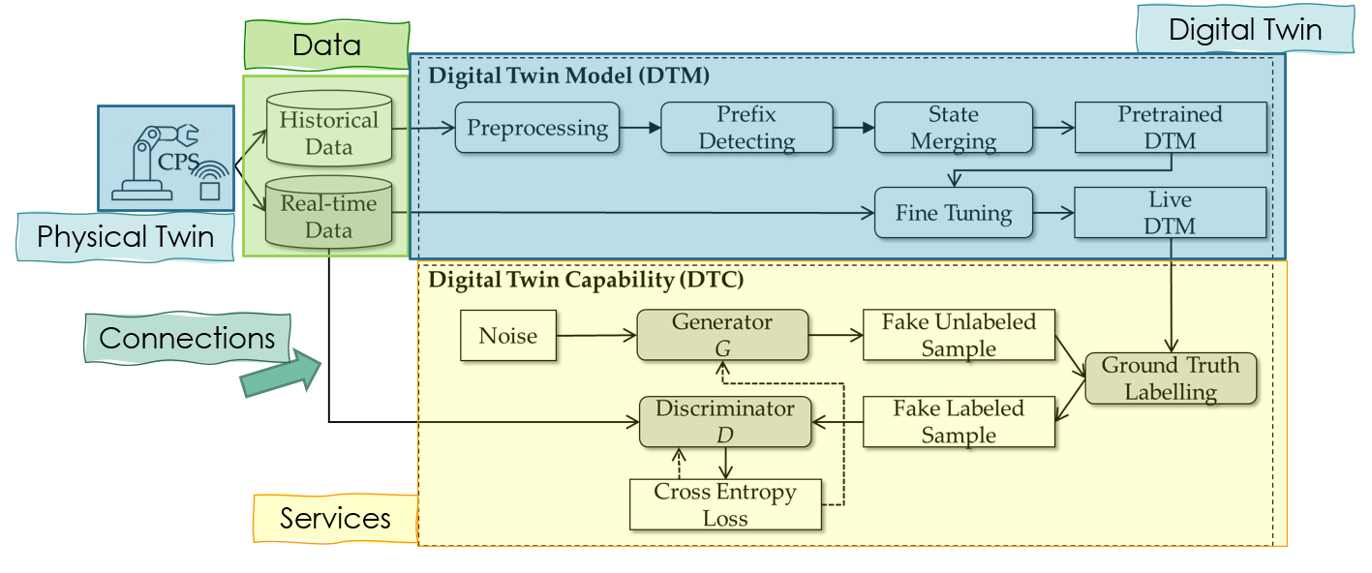
Architectures in the Literature

Slide 23
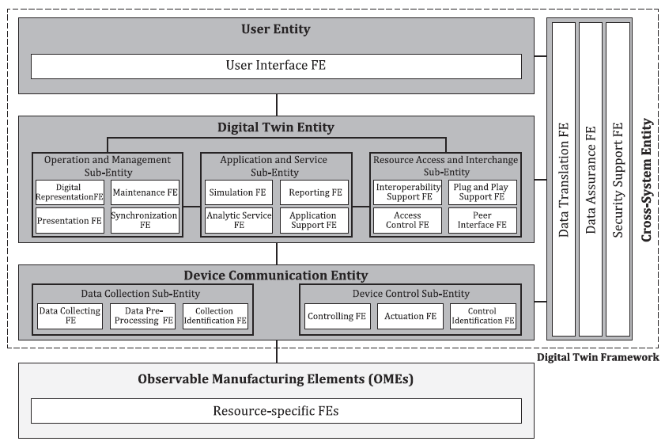
Digital Twin Architecture in MontiArch
Services
Digital Twin
Data
Physical Twin
Connections
M. Dalibor, J. Michael, B. Rumpe, S. Varga, and A. Wortmann, “Towards a model-driven architecture for interactive digital twin cockpits,” In Proc. ER’20.

Slide 24
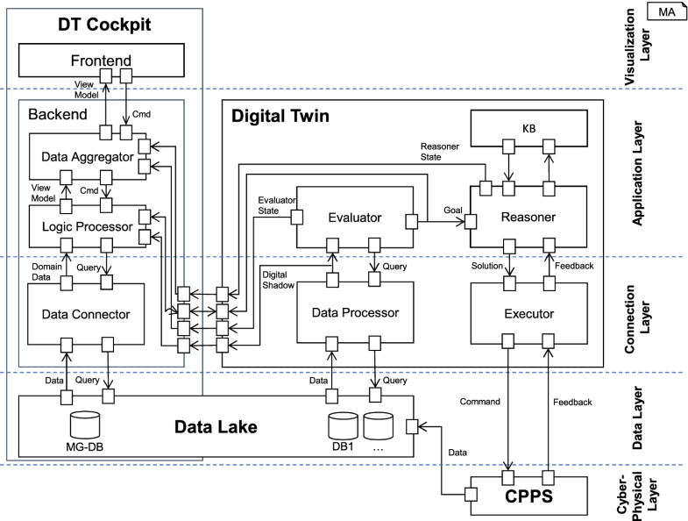
Digital Twin Architecture by ISO
Services
Digital Twin
Connections
Connections
Connections
Data
Physical Twin
ISO 23247:2021, Automation systems and integration – Digital Twin Framework for manufacturing, International Organization for Standardization (ISO), 2021.

Slide 25
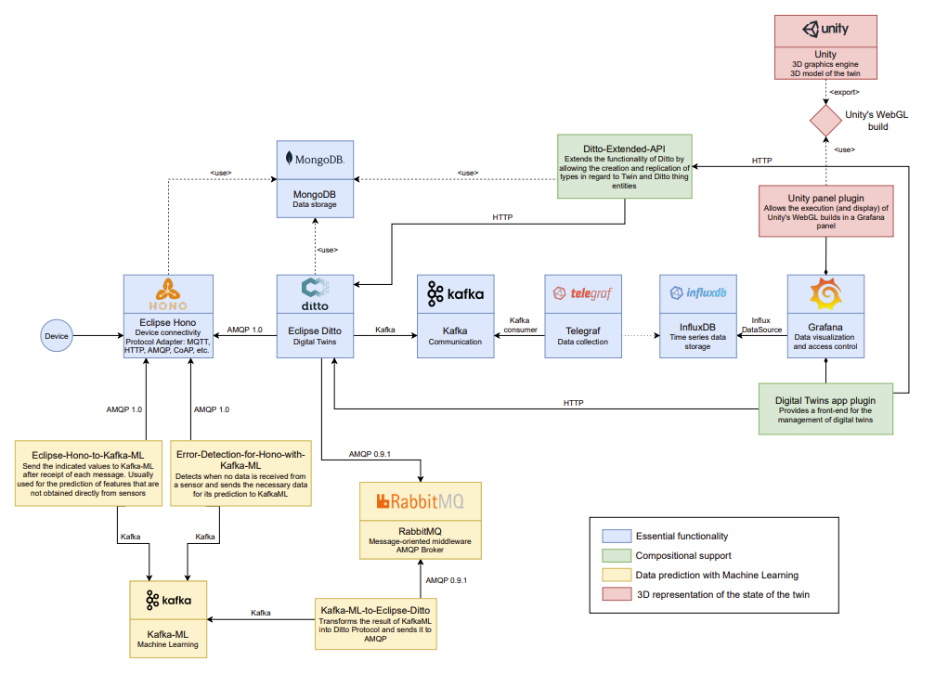
Digital Twin Architecture in OpenTwins
Services
Data
Connections
Connections
Physical Twin
Digital Twin
J. Robles, C. Martin and M- Diaz - OpenTwins: an open-source framework for the development of next-gen compositional digital twins
Digital Twins - 25

Slide 26
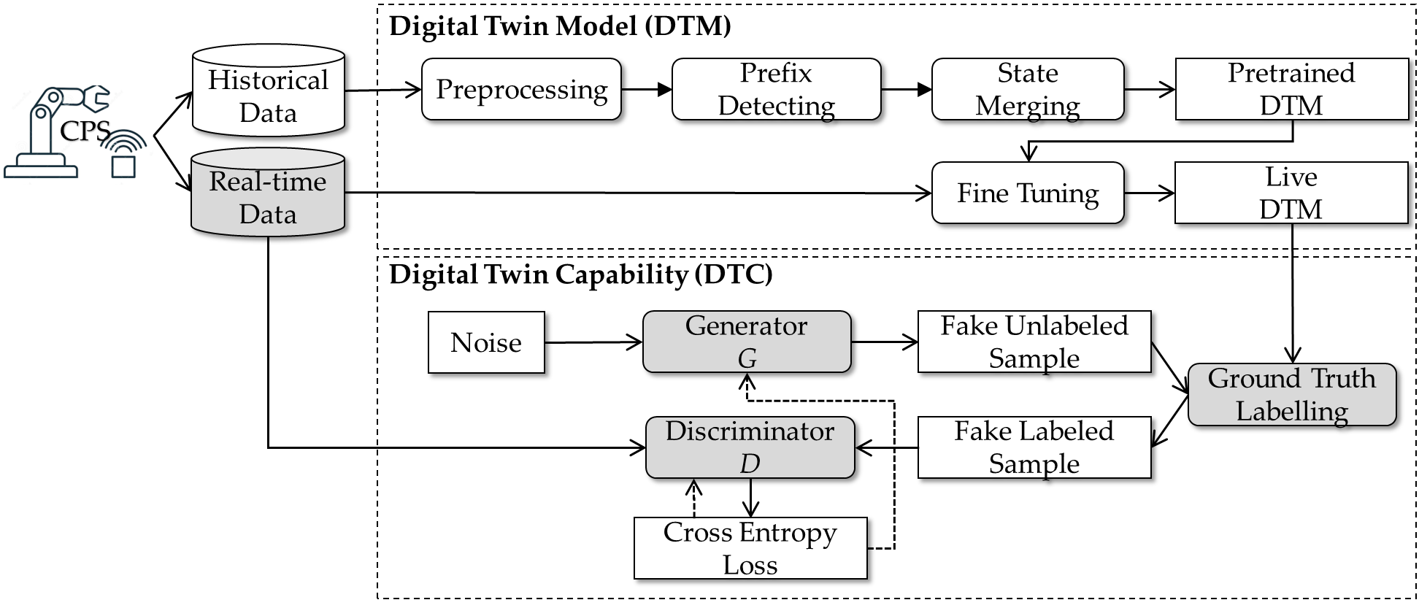
Digital Twin Architecture for CPS
Digital Twin
Data
Physical Twin
Connections
Services
Q. Xu, S. Ali, and T. Yue. 2023. Digital Twin-based Anomaly Detection with Curriculum Learning in Cyber-physical Systems. ACM Trans. Softw. Eng. Methodol. 32, 5, Article 113 (September 2023), 32 pages.

Slide 27
Fields of application
Digital Twins can be used in virtually any field:
Manufacturing: Monitor machinery for predictive maintenance.
Smart cities: Model traffic flow, infrastructures, or energy use.
Healthcare: Simulate patient health scenarios.
Aerospace & automotive: Test performance or design changes.
Manufacturing | 252 | 70,79%
Information and Communication | 47 | 13,20%
Energy | 17 | 4,77%
Construction | 12 | 3,37%
Mining | 9 | 2,53%
Sanidad | 8 | 2,25%
Transportation and Storage | 6 | 1,68%
Education | 4 | 1,12%
Agriculture | 1 | 0,28%

Slide 28

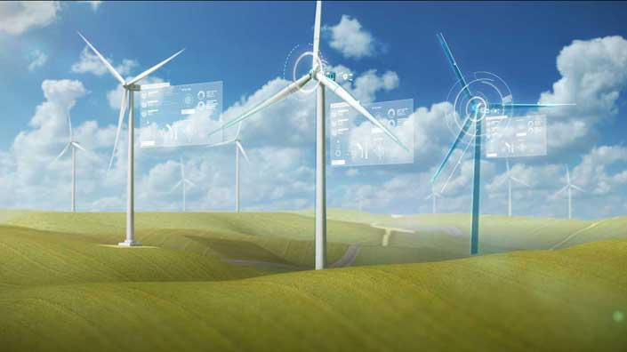
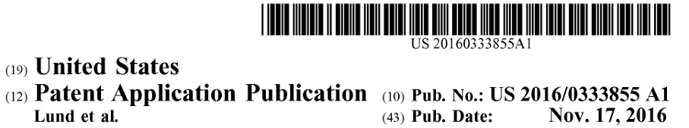
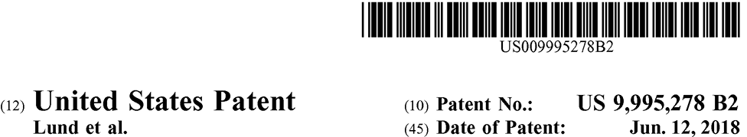
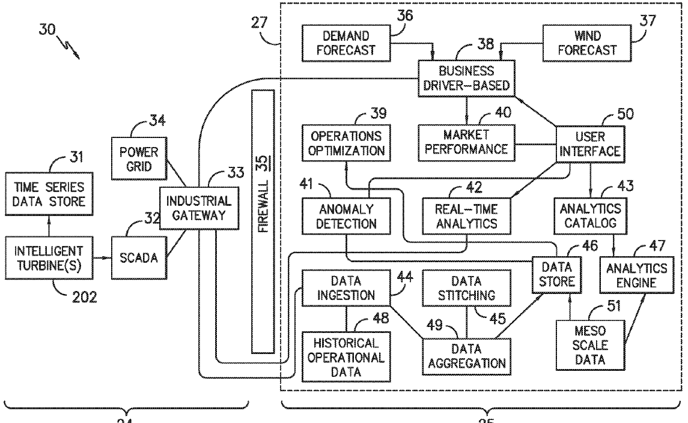
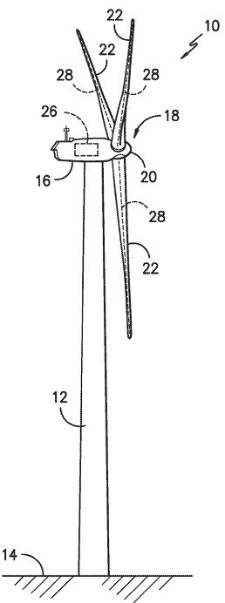
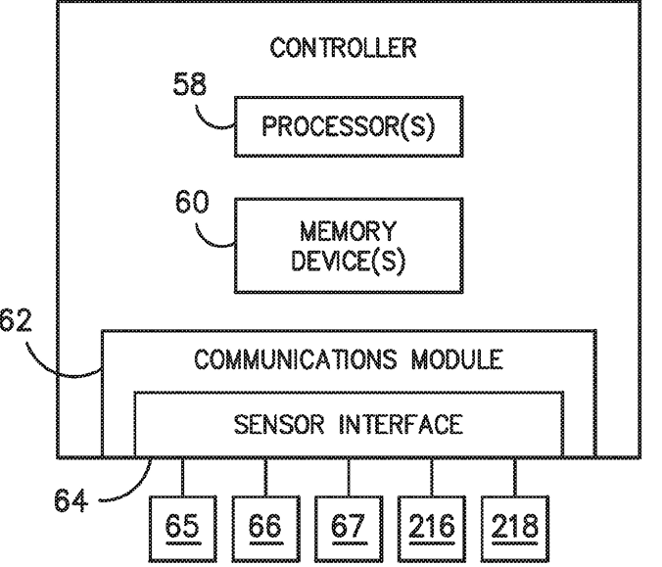
Some Applications
Digital Wind Farm System
A. M. Lund et al., “Digital twin interface for operating wind farms,” U.S. Patent 9 995 278, Jun. 12, 2018
A. M. Lund et al., “Digital wind farm system,” U.S. Patent Application 15/075 231, Nov. 17, 2016
Notes:
General Electric (GE) owns four patents that are directly related to DTs. Two of them are concerning wind farms. GE [55] invented the DT of a wind farm, which included two communication networks. The first network connects the control systems of wind turbines in a wind farm. The second network connects the digital models of wind turbines in the cloud. The digital models are constantly updated based on data collected from the first network. The system can monitor the running states of wind turbines through sensors, and control their operations through the digital models. Furthermore, GE developed a DT interface [56] to manage multiple digital models at the same time. The proposed interface has a graphical user interface to display the digital mirror of a wind farm. The interface includes a control icon that contains information about the latest operating conditions of each wind turbine, and some control features that can be (re)configured to optimize the performance of the wind farm. Besides, the patent introduces some new methods to develop the wind farm DT and assess the operating state based on the DT.

Slide 29

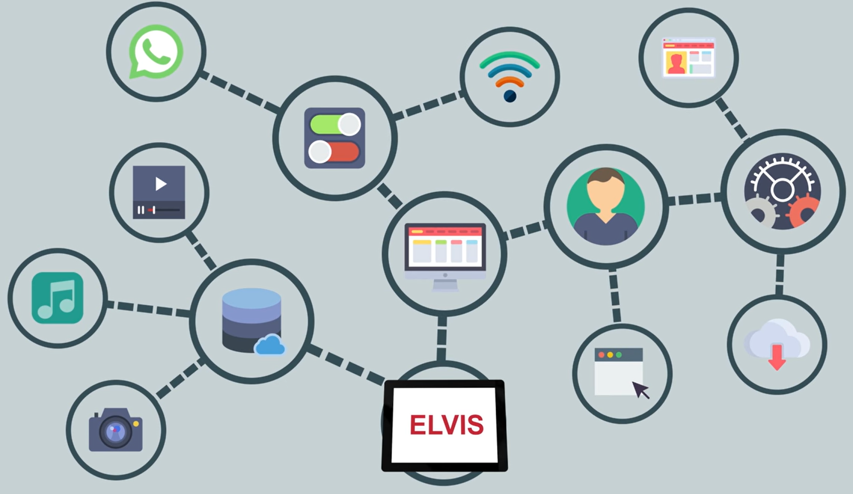
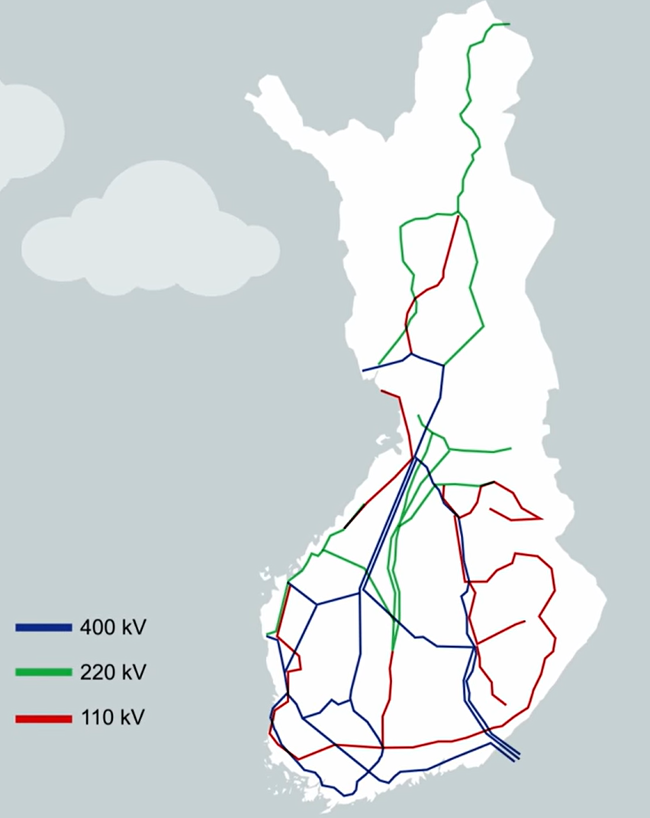
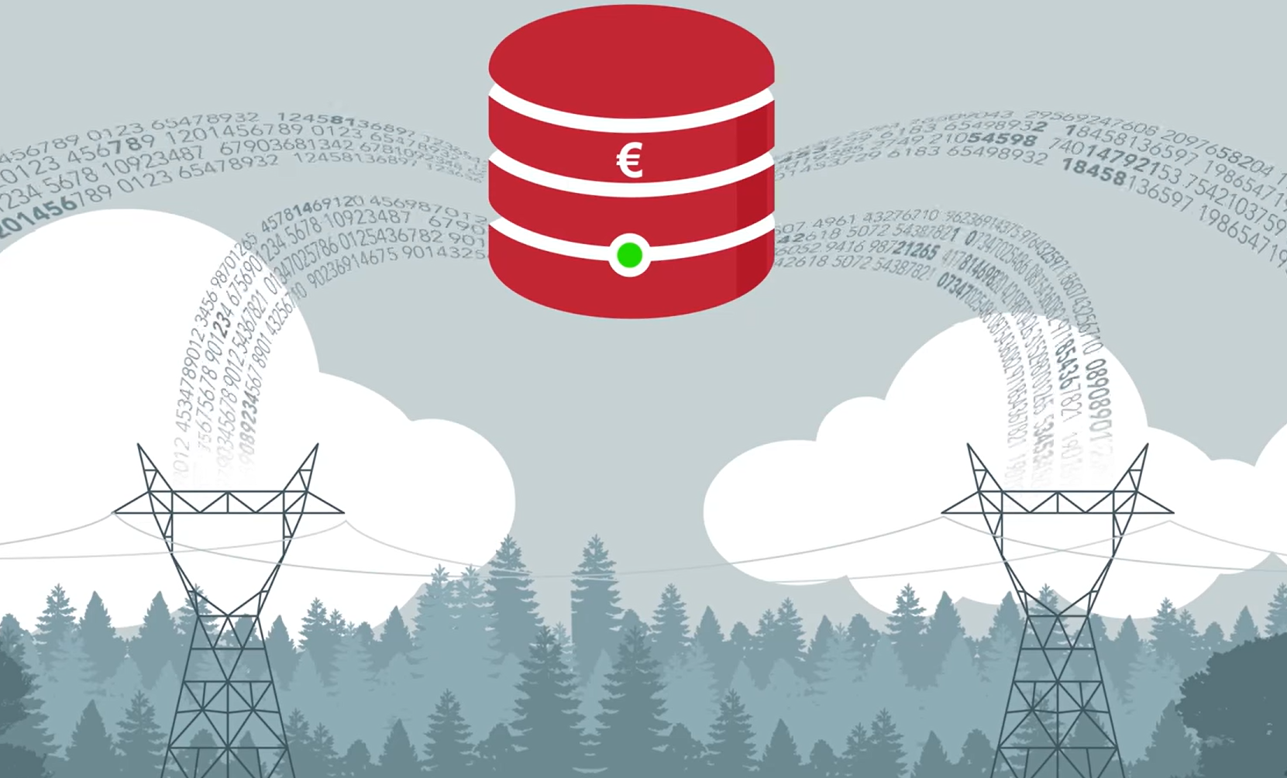
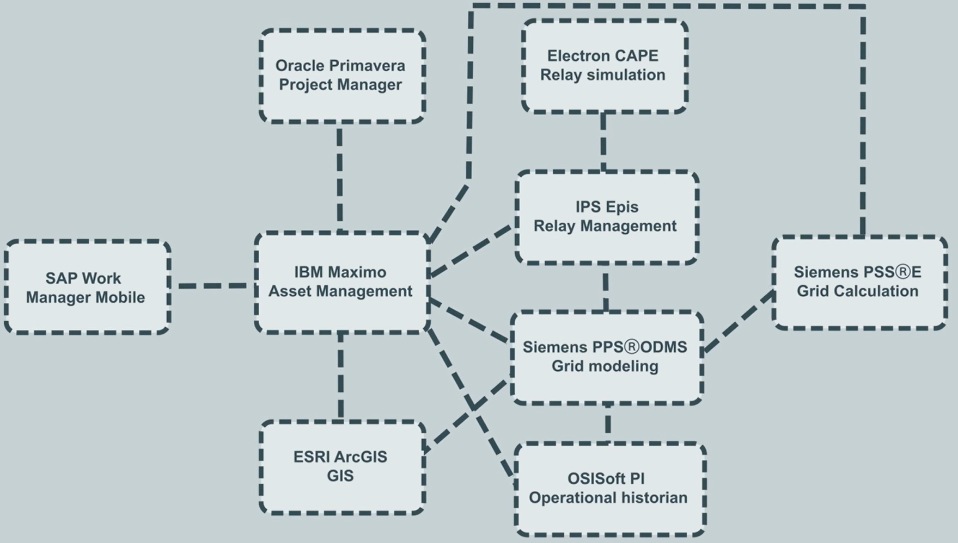
Some Applications
Finland’s Electricity Network
Siemens, For a digital twin of the grid Siemens solution enables a single grid model of the Finnish power system, [Online], 2017.
Notes:
Siemens applied DTs for the power system and wastewater plant. It developed the DT for the planning, operation, and maintenance of a power system in Finland, which significantly improved the automation, data utilization, and decision making [63].

Slide 30



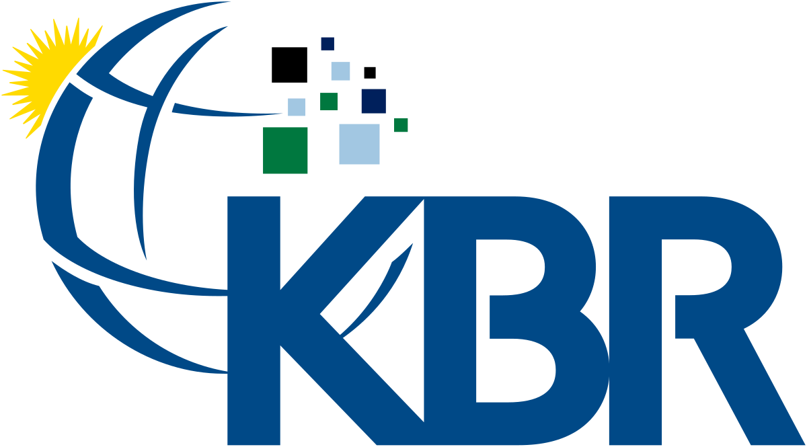
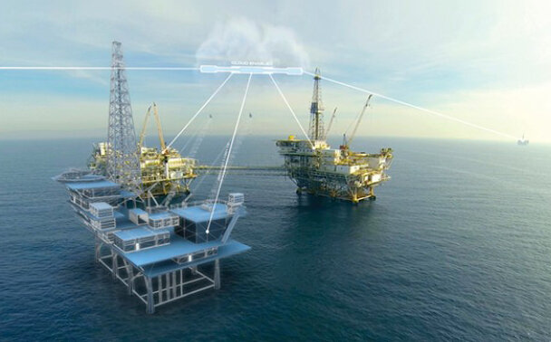
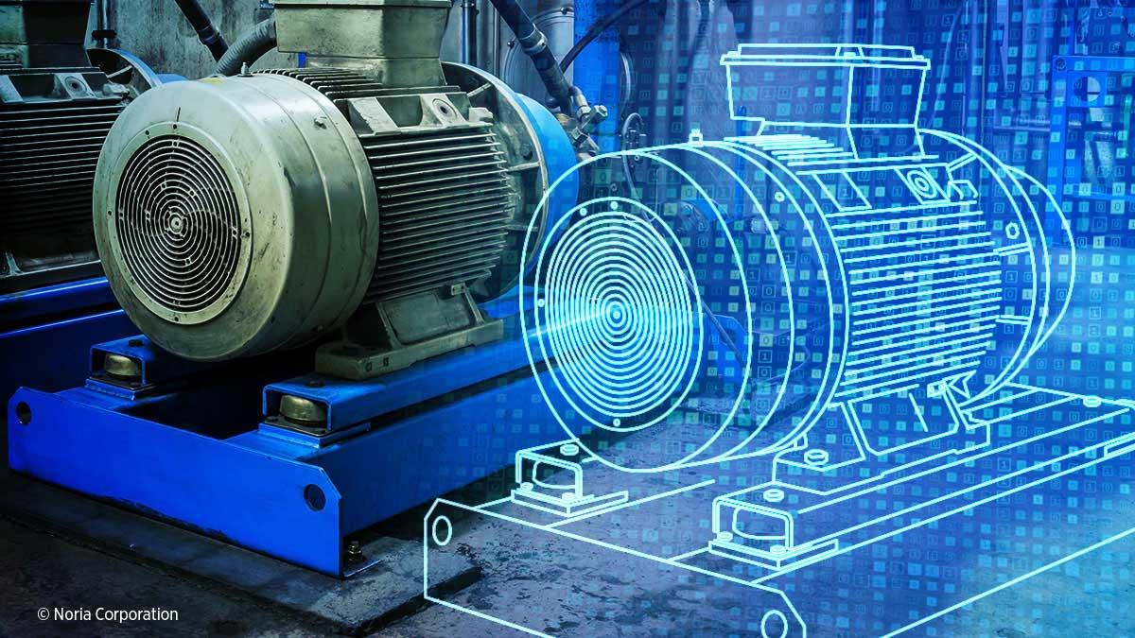
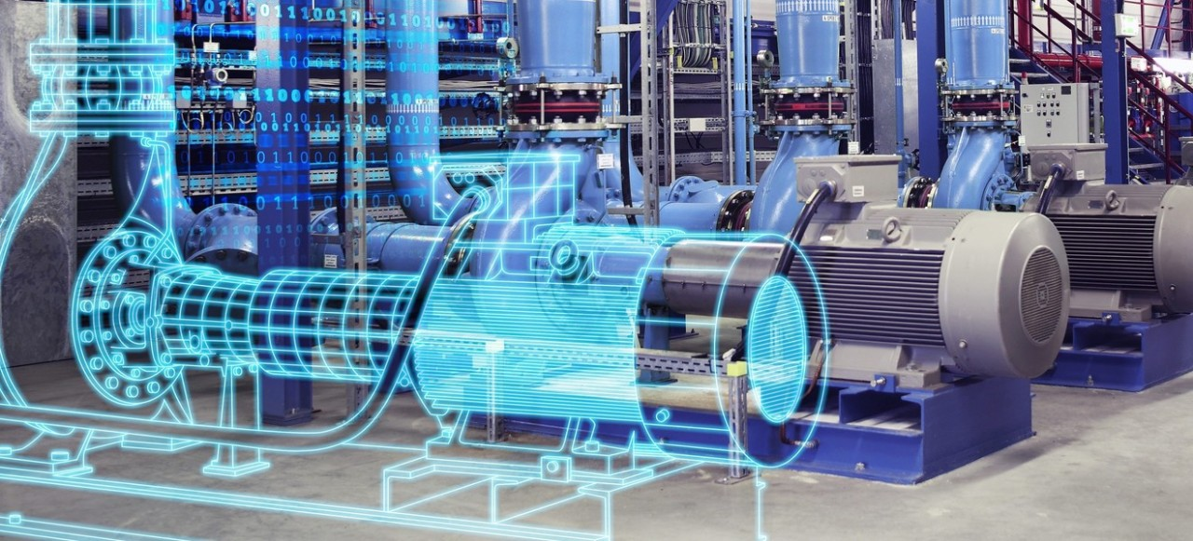
Some Applications
Oil and gas extraction
Digital Twin Insider, BP Digital Twin Technology to Enhance Global Oil and Gas Operations,
[Online], 2024.
Notes:
Siemens applied DTs for the power system and wastewater plant. It developed the DT for the planning, operation, and maintenance of a power system in Finland, which significantly improved the automation, data utilization, and decision making [63].

Slide 31

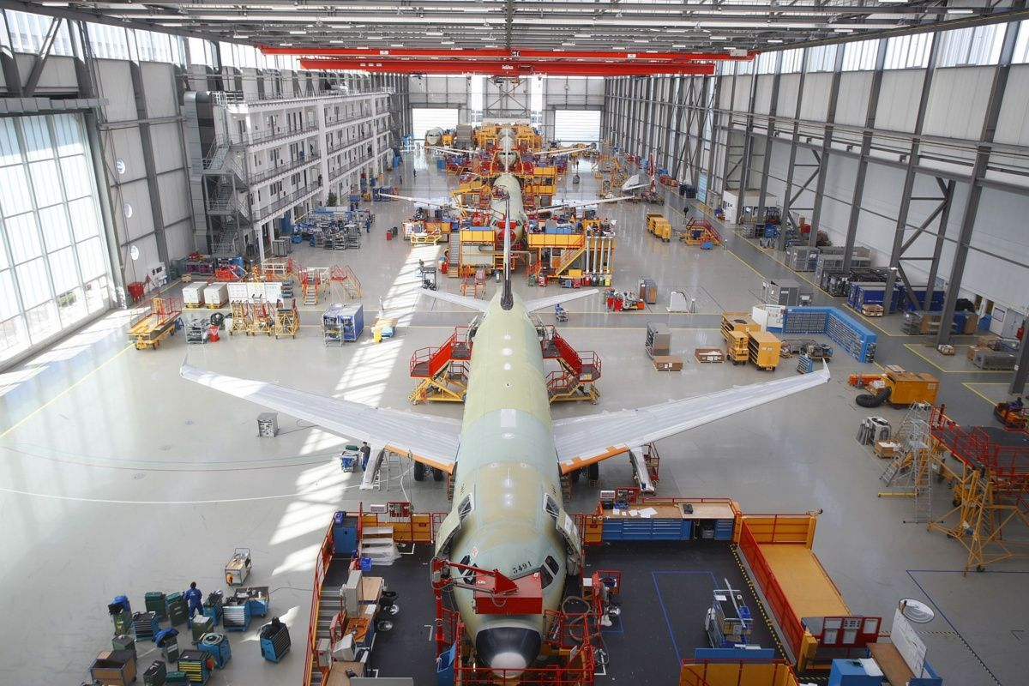
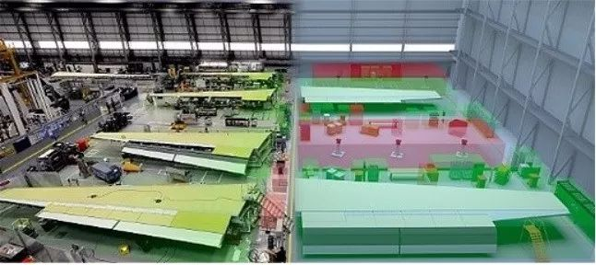
Some Applications
Oil and gas extraction
SME, IIoT Platform Creates A Digital Twin of F-35 Manufacturing Facilities, [Online], 2017.
Notes:
Lockheed Martin Aeronautics has licensed Ubisense Smart Space for deployment at its F-35 program at Fort Worth, TX, to improve manufacturing efficiency with a digital twin. Delivering new levels of visibility and control, SmartSpace provides a foundation platform for manufacturers’ Industry 4.0 strategy. Creating a real-time digital twin of the production environment, Ubisense’s technology connects activities in the real world to manufacturing execution and planning systems, making real-world processes involving moving assets visible and measurable.
Ubisense SmartSpace changes the way aerospace manufacturers deliver aircraft on time and to budget, providing complete visibility of the manufacturing process by integrating location technologies into a single operational view of production. For Airbus, Ubisense provides an ‘indoor radar’, connecting with SAP to ensure timely arrival of components for assembly and up-to-date information management.
SmartSpace is proven to solve a number of challenges faced by manufacturers with long cycle times and high complexity such as those in aerospace, defense and commercial vehicles. For these customers sites are often vast, making it easy to lose sight of tools and assets. However, if these critical items are not in the right place at the right time it can cause lengthy and very expensive production delays.
By understanding the precise location of tagged assets in real-time, as well as where they need to be at specific points in the future, SmartSpace enables the proactive staging and scheduling of assets to help meet critical milestones. The platform doesn’t just tell you where assets are but provides a high level of control to ensure that uncontrolled or incorrect tools are not used in specified workspaces.
Problems in the manufacturing and delivery of component parts can mean delays in final assembly and missed delivery dates, which can lead to hefty fines. By tracking the progress of parts across sub-assembly lines, at multiple plants, SmartSpace enables manufacturers to proactively plan final assembly based on delivery delays.

Slide 32
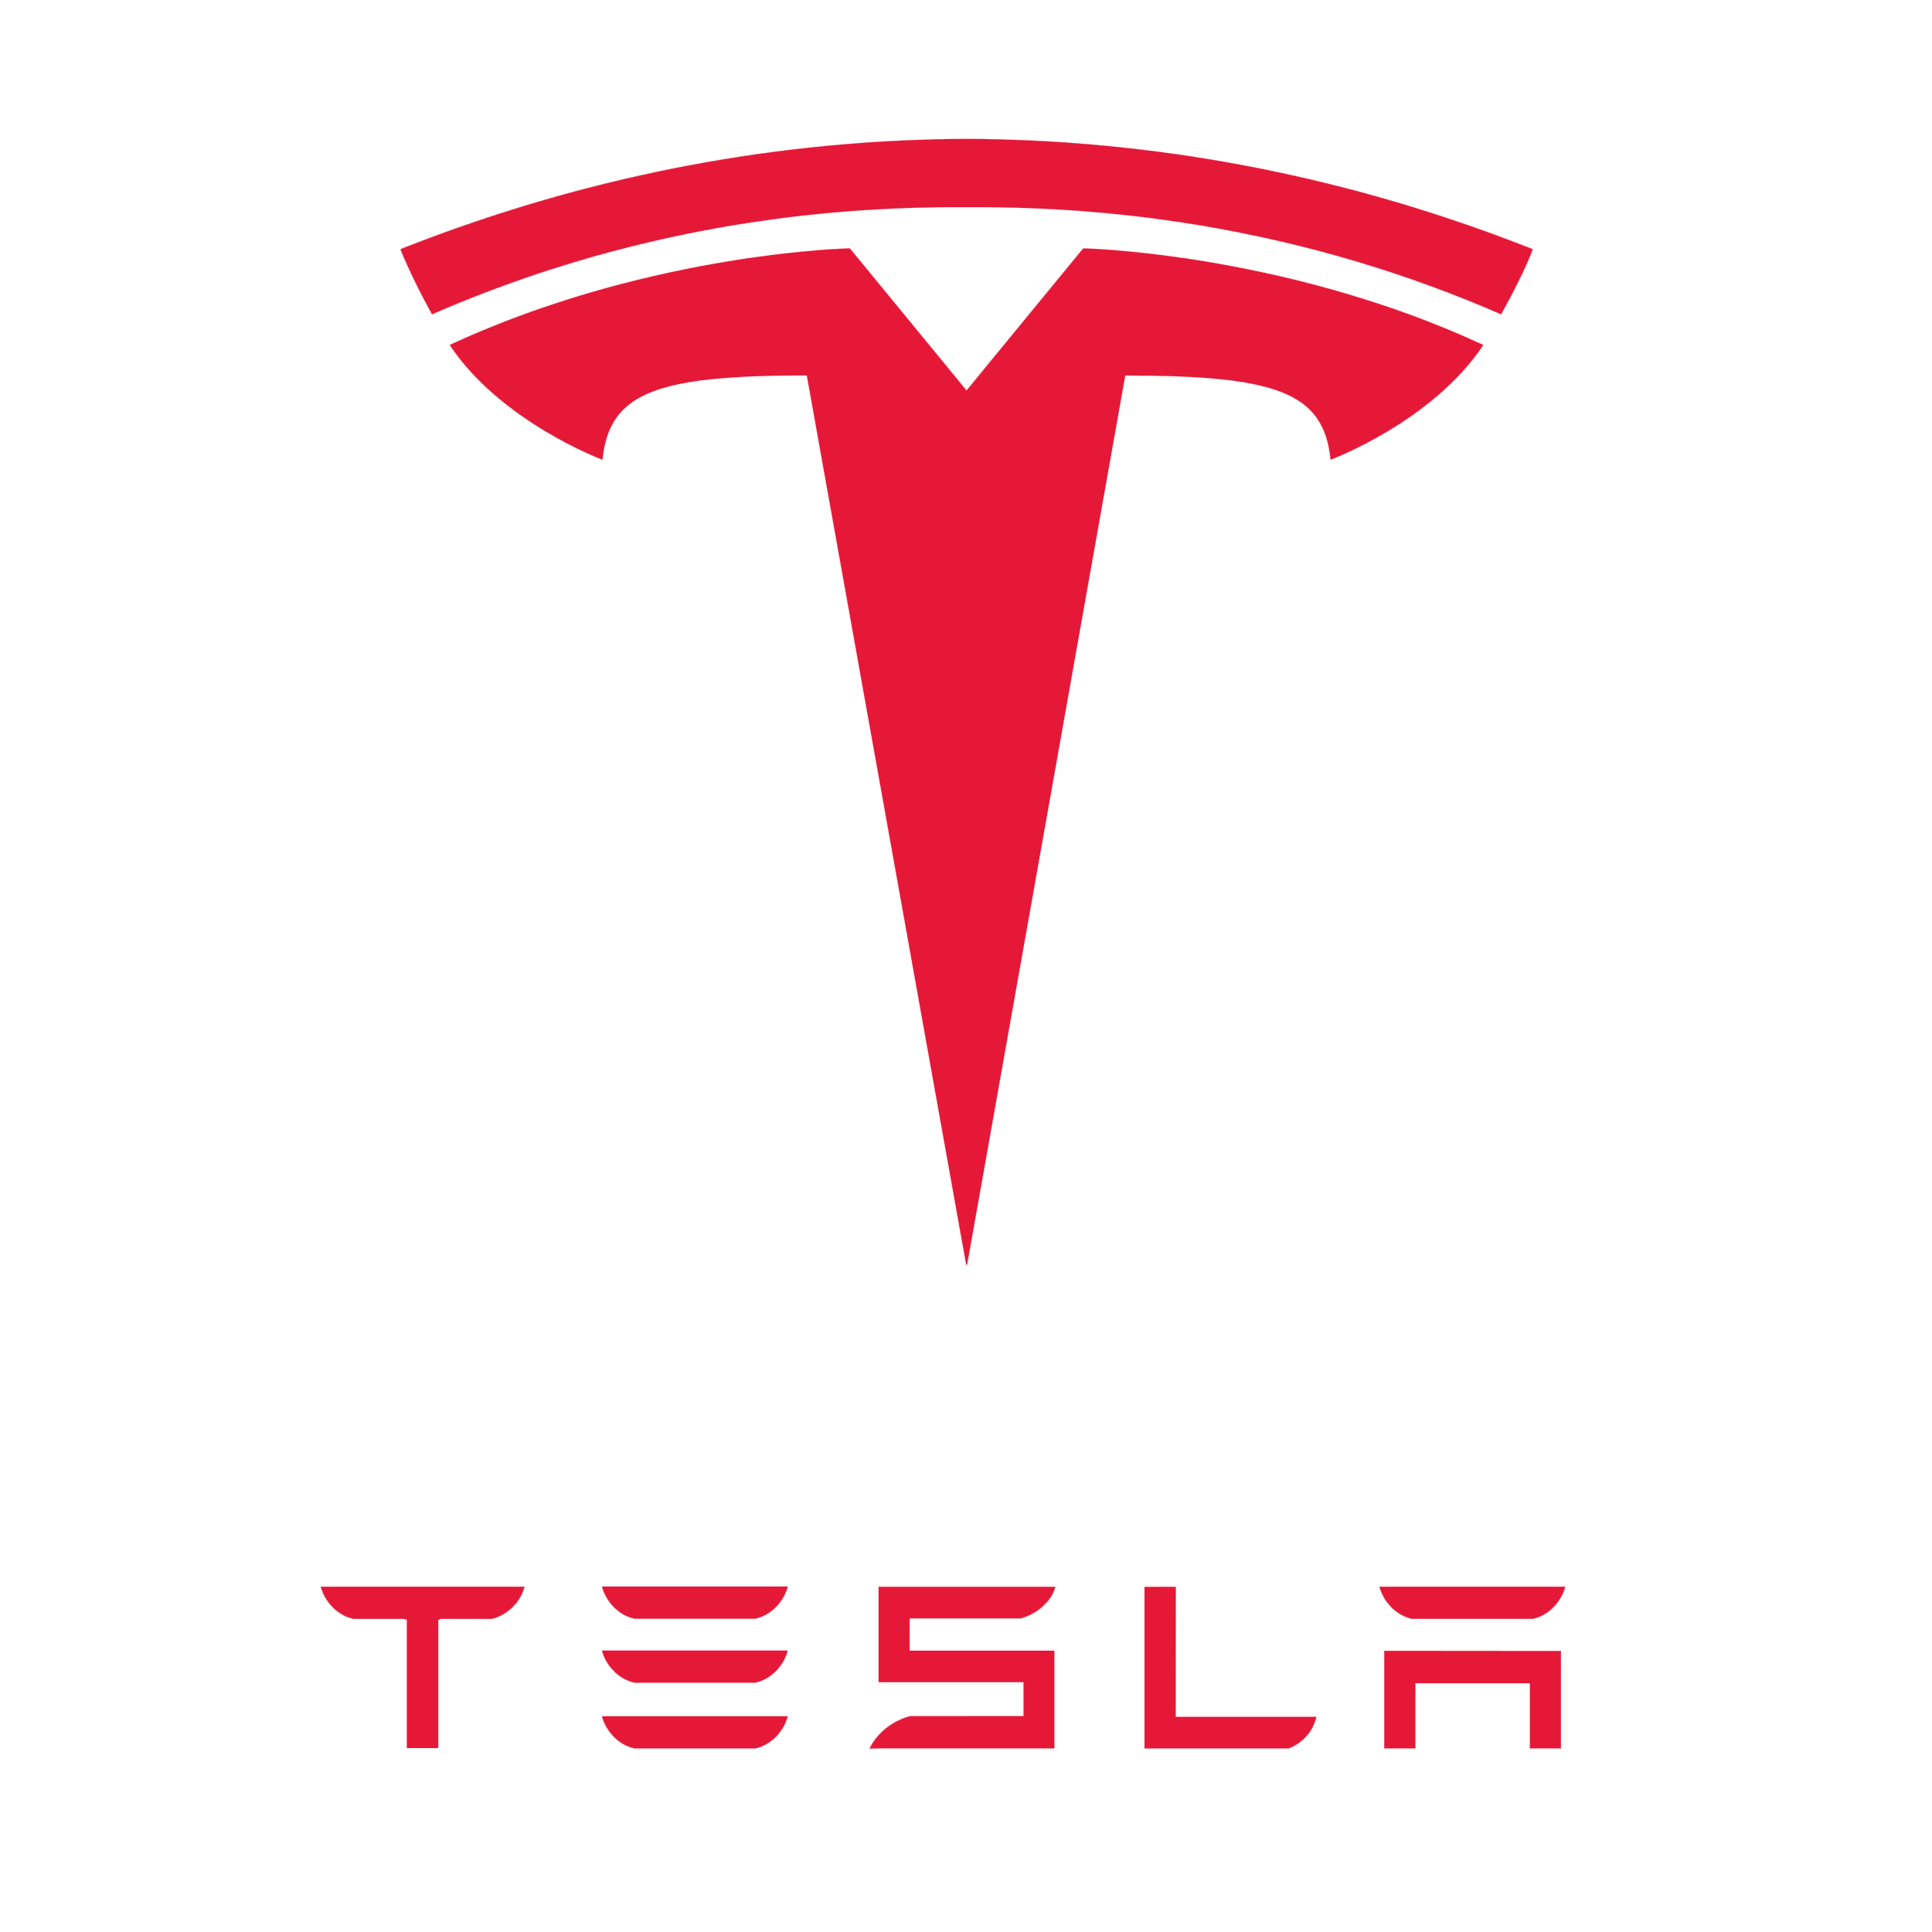
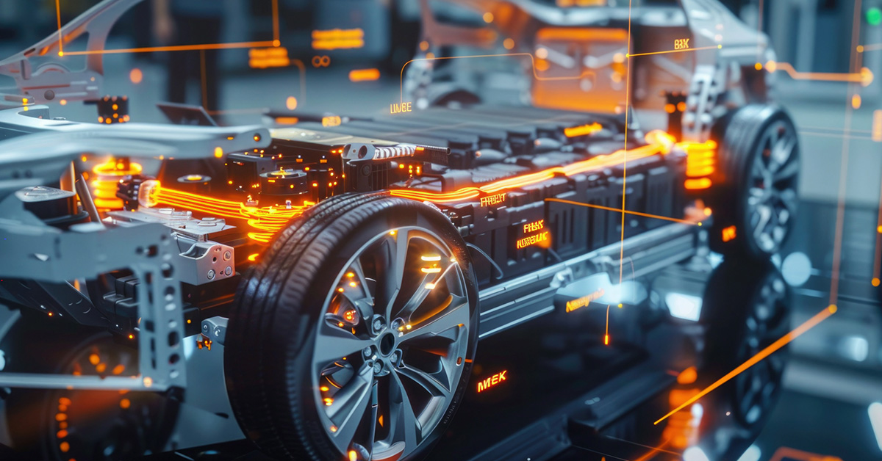
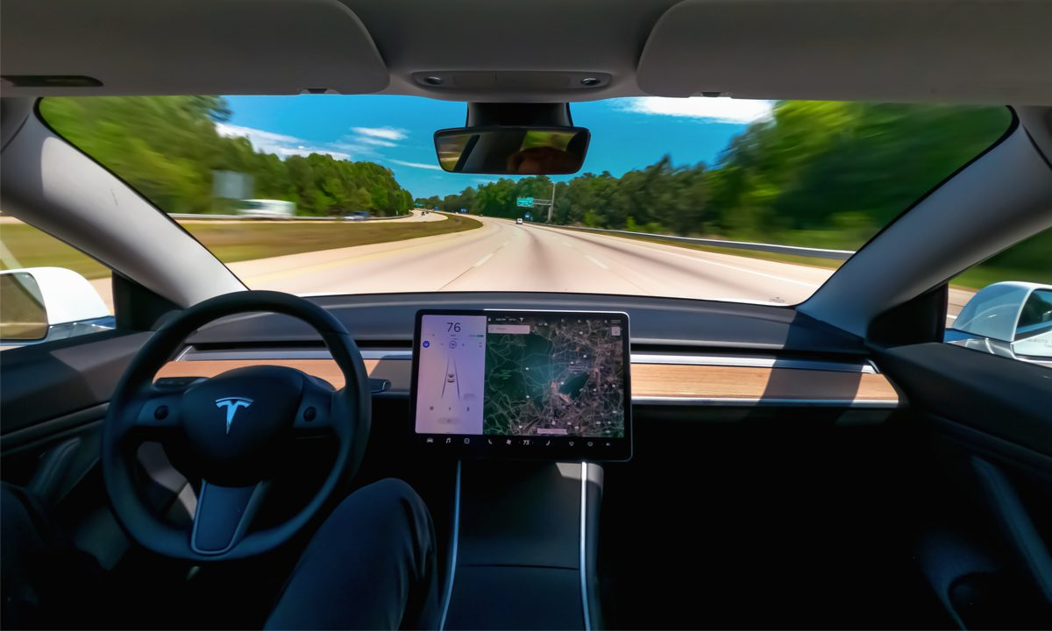
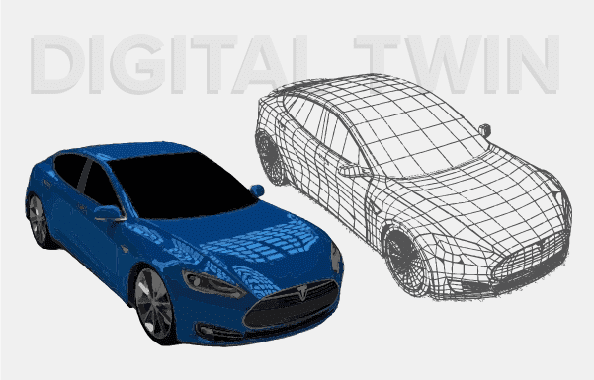
Some Applications
Tesla’s Digital Twins
“Literally every Tesla sold has a digital representation that reflects its real-world counterpart”
M. Kalil, Tesla’s Digital Twins, [Online], 2024.
Notes:
Each Tesla digital twin collects and processes real-time data from its corresponding vehicle, including performance metrics, sensor readings, operational conditions, and more.
The sheer volume of information collected and transmitted to Tesla’s data centers requires substantial network bandwidth and infrastructure.
From there, complex algorithms and machine learning models extract meaningful insights, which requires the most powerful CPUs and GPUs. Data from millions of vehicles, collected over time, must also be stored securely and efficiently, necessitating leading-edge data storage solutions.
Tesla uses this real-time data to continuously improve vehicle performance, predict maintenance needs, and offer over-the-air software updates.
With Tesla’s digital twin strategy, each vehicle effectively becomes a source of real-time operational data.
The insights inform Tesla on everything from battery life to motor function to autopilot behavior.
As applied by Tesla, digital twinning goes far beyond predictive maintenance and software enhancement. They’re used to advance autonomous driving capabilities and overall user experience.
While it’s not yet standard practice for every manufacturer to create digital twins for every vehicle sold, the automotive industry was among the early adopters of the technology.

Slide 33
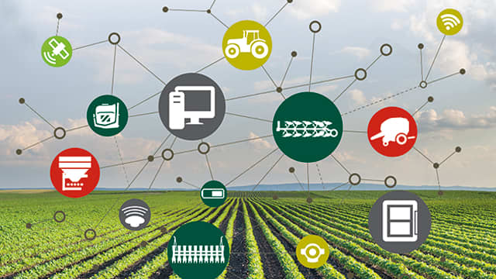


Some Applications
Agriculture
Addressing issues such as:
Farms and animal welfare
Irrigation
Resource usage
Machinery
Crop yield
C. Verdouw, B. Tekinerdogan, A. Beulens, S. Wolfert. Digital twins in smart farming, Agricultural Systems, vol. 189, 2021, DOI: https://doi.org/10.1016/j.agsy.2020.103046
Notes:
Each Tesla digital twin collects and processes real-time data from its corresponding vehicle, including performance metrics, sensor readings, operational conditions, and more.
The sheer volume of information collected and transmitted to Tesla’s data centers requires substantial network bandwidth and infrastructure.
From there, complex algorithms and machine learning models extract meaningful insights, which requires the most powerful CPUs and GPUs. Data from millions of vehicles, collected over time, must also be stored securely and efficiently, necessitating leading-edge data storage solutions.
Tesla uses this real-time data to continuously improve vehicle performance, predict maintenance needs, and offer over-the-air software updates.
With Tesla’s digital twin strategy, each vehicle effectively becomes a source of real-time operational data.
The insights inform Tesla on everything from battery life to motor function to autopilot behavior.
As applied by Tesla, digital twinning goes far beyond predictive maintenance and software enhancement. They’re used to advance autonomous driving capabilities and overall user experience.
While it’s not yet standard practice for every manufacturer to create digital twins for every vehicle sold, the automotive industry was among the early adopters of the technology.

Slide 34


Some Applications
Smart Cities
Urban Digital Twins (UDTs)
Addressing issues such as:
Urban planning
City infrastructures
Traffic
Energy consumption
N. Mohammadi and J. E. Taylor, "Smart city digital twins," 2017 IEEE Symposium Series on Computational Intelligence (SSCI), Honolulu, 2017, pp. 1-5, doi:10.1109/SSCI.2017.8285439.
Notes:
Each Tesla digital twin collects and processes real-time data from its corresponding vehicle, including performance metrics, sensor readings, operational conditions, and more.
The sheer volume of information collected and transmitted to Tesla’s data centers requires substantial network bandwidth and infrastructure.
From there, complex algorithms and machine learning models extract meaningful insights, which requires the most powerful CPUs and GPUs. Data from millions of vehicles, collected over time, must also be stored securely and efficiently, necessitating leading-edge data storage solutions.
Tesla uses this real-time data to continuously improve vehicle performance, predict maintenance needs, and offer over-the-air software updates.
With Tesla’s digital twin strategy, each vehicle effectively becomes a source of real-time operational data.
The insights inform Tesla on everything from battery life to motor function to autopilot behavior.
As applied by Tesla, digital twinning goes far beyond predictive maintenance and software enhancement. They’re used to advance autonomous driving capabilities and overall user experience.
While it’s not yet standard practice for every manufacturer to create digital twins for every vehicle sold, the automotive industry was among the early adopters of the technology.

Slide 35


Some Applications
Healthcare
Addressing issues such as:
Developping personalized treatments
Drug discovery and development
Monitoring chronic disease healthdata
Organ-specific digital twins: heart, lung, kidney,...
Optimizing hospital operation and workflows
Training surgeons
Emergency response
Remote patient monitoring
Population health
Katsoulakis, E., Wang, Q., Wu, H. et al. Digital twins for health: a scoping review. Digit. Med. 7, 77 (2024). https://doi.org/10.1038/s41746-024-01073-0
Notes:
Each Tesla digital twin collects and processes real-time data from its corresponding vehicle, including performance metrics, sensor readings, operational conditions, and more.
The sheer volume of information collected and transmitted to Tesla’s data centers requires substantial network bandwidth and infrastructure.
From there, complex algorithms and machine learning models extract meaningful insights, which requires the most powerful CPUs and GPUs. Data from millions of vehicles, collected over time, must also be stored securely and efficiently, necessitating leading-edge data storage solutions.
Tesla uses this real-time data to continuously improve vehicle performance, predict maintenance needs, and offer over-the-air software updates.
With Tesla’s digital twin strategy, each vehicle effectively becomes a source of real-time operational data.
The insights inform Tesla on everything from battery life to motor function to autopilot behavior.
As applied by Tesla, digital twinning goes far beyond predictive maintenance and software enhancement. They’re used to advance autonomous driving capabilities and overall user experience.
While it’s not yet standard practice for every manufacturer to create digital twins for every vehicle sold, the automotive industry was among the early adopters of the technology.

Slide 36

Some Applications
Information and Communication
Addressing issues such as:
Network infrastructures
Ericsson Site Digital Twin
Telecom sites
UE Hexa-X 6G project
R. Dong, et al., "Deep Learning for Hybrid 5G Services in Mobile Edge Computing Systems: Learn From a Digital Twin," in IEEE Trans. Wireless Communications, vol. 18, no. 10, pp. 4692-4707, Oct. 2019, doi: 10.1109/TWC.2019.2927312.
Notes:
Each Tesla digital twin collects and processes real-time data from its corresponding vehicle, including performance metrics, sensor readings, operational conditions, and more.
The sheer volume of information collected and transmitted to Tesla’s data centers requires substantial network bandwidth and infrastructure.
From there, complex algorithms and machine learning models extract meaningful insights, which requires the most powerful CPUs and GPUs. Data from millions of vehicles, collected over time, must also be stored securely and efficiently, necessitating leading-edge data storage solutions.
Tesla uses this real-time data to continuously improve vehicle performance, predict maintenance needs, and offer over-the-air software updates.
With Tesla’s digital twin strategy, each vehicle effectively becomes a source of real-time operational data.
The insights inform Tesla on everything from battery life to motor function to autopilot behavior.
As applied by Tesla, digital twinning goes far beyond predictive maintenance and software enhancement. They’re used to advance autonomous driving capabilities and overall user experience.
While it’s not yet standard practice for every manufacturer to create digital twins for every vehicle sold, the automotive industry was among the early adopters of the technology.

Slide 37


Some Applications
Artax – a DT for people’s movement in crowds
as part of the research project:
Including People in Smart City Applications
the phone builds a Digital Avatar of its owner
virtual profile with their habits, preferences, etc.
including their movements as a sequence of GPS positions
that can be served to third-parties on demand
Individuals are considered as first-class entities of the DT
providing RT information from individuals in a specific area
A. Perez-Vereda, R. Hervas, C. Canal. Digital Avatars: A programming framework for personalized human interactions through virtual profiles. Pervasive and Mobile Computing, 87:101718 (17 pp.), Elsevier, 2022.
I. Alba, J. Troya, C. Canal. Towards a Digital Twin System for Human Crowd Motion Prediction. EDOC 2024. Lecture Notes in Business Information Processing, vol 537. Springer (2025).
Digital Twins - 37
Notes:
Each Tesla digital twin collects and processes real-time data from its corresponding vehicle, including performance metrics, sensor readings, operational conditions, and more.
The sheer volume of information collected and transmitted to Tesla’s data centers requires substantial network bandwidth and infrastructure.
From there, complex algorithms and machine learning models extract meaningful insights, which requires the most powerful CPUs and GPUs. Data from millions of vehicles, collected over time, must also be stored securely and efficiently, necessitating leading-edge data storage solutions.
Tesla uses this real-time data to continuously improve vehicle performance, predict maintenance needs, and offer over-the-air software updates.
With Tesla’s digital twin strategy, each vehicle effectively becomes a source of real-time operational data.
The insights inform Tesla on everything from battery life to motor function to autopilot behavior.
As applied by Tesla, digital twinning goes far beyond predictive maintenance and software enhancement. They’re used to advance autonomous driving capabilities and overall user experience.
While it’s not yet standard practice for every manufacturer to create digital twins for every vehicle sold, the automotive industry was among the early adopters of the technology.

Slide 38



Some Applications
A DT of Noisy Quantum Computers
parametric error model of transmon qubit devices
for understanding and mitigating noise in NISQ QPUs
C. Gustiani, T. Jones, S. C. Benjamin. The Virtual Quantum Device (VQD): A tool for detailed emulation of quantum computers. Quantum 9: 1642 (2025).
Notes:
Each Tesla digital twin collects and processes real-time data from its corresponding vehicle, including performance metrics, sensor readings, operational conditions, and more.
The sheer volume of information collected and transmitted to Tesla’s data centers requires substantial network bandwidth and infrastructure.
From there, complex algorithms and machine learning models extract meaningful insights, which requires the most powerful CPUs and GPUs. Data from millions of vehicles, collected over time, must also be stored securely and efficiently, necessitating leading-edge data storage solutions.
Tesla uses this real-time data to continuously improve vehicle performance, predict maintenance needs, and offer over-the-air software updates.
With Tesla’s digital twin strategy, each vehicle effectively becomes a source of real-time operational data.
The insights inform Tesla on everything from battery life to motor function to autopilot behavior.
As applied by Tesla, digital twinning goes far beyond predictive maintenance and software enhancement. They’re used to advance autonomous driving capabilities and overall user experience.
While it’s not yet standard practice for every manufacturer to create digital twins for every vehicle sold, the automotive industry was among the early adopters of the technology.

Slide 39
Research Challenges
Many industrial initiatives for building DTs
developed in an ad-hoc manner
Lack of Software Engineering methods in their development
standards
methodologies
frameworks & tools
data fusion & curation
interoperability, composition & deployment
validation & evaluation
We find efforts in all these fields but not clear outcomes yet
A. Sharma, E. Kosasih, J. Zhang, A. Brintrup, A. Calinescu. Digital Twins: State of the art theory and practice, challenges, and open research questions, Journal of Industrial Information Integration,
vol 30, 2022, 100383. https://doi.org/10.1016/j.jii.2022.100383.
Notes:
Each Tesla digital twin collects and processes real-time data from its corresponding vehicle, including performance metrics, sensor readings, operational conditions, and more.
The sheer volume of information collected and transmitted to Tesla’s data centers requires substantial network bandwidth and infrastructure.
From there, complex algorithms and machine learning models extract meaningful insights, which requires the most powerful CPUs and GPUs. Data from millions of vehicles, collected over time, must also be stored securely and efficiently, necessitating leading-edge data storage solutions.
Tesla uses this real-time data to continuously improve vehicle performance, predict maintenance needs, and offer over-the-air software updates.
With Tesla’s digital twin strategy, each vehicle effectively becomes a source of real-time operational data.
The insights inform Tesla on everything from battery life to motor function to autopilot behavior.
As applied by Tesla, digital twinning goes far beyond predictive maintenance and software enhancement. They’re used to advance autonomous driving capabilities and overall user experience.
While it’s not yet standard practice for every manufacturer to create digital twins for every vehicle sold, the automotive industry was among the early adopters of the technology.

Slide 40

Composition of DTs
Integration of citizens into UDTs through their Digital Avatars
Case study: Public transportation system of the city of Malaga
R. García-Luque, L. Toro-Gálvez, N. Moreno, J. Troya, C. Canal and E. Pimentel. "Integrating Citizens’ Avatars in Urban Digital Twins". Journal of Web Engineering, 22(06):913–938, Elsevier, 2023.
Notes:
Each Tesla digital twin collects and processes real-time data from its corresponding vehicle, including performance metrics, sensor readings, operational conditions, and more.
The sheer volume of information collected and transmitted to Tesla’s data centers requires substantial network bandwidth and infrastructure.
From there, complex algorithms and machine learning models extract meaningful insights, which requires the most powerful CPUs and GPUs. Data from millions of vehicles, collected over time, must also be stored securely and efficiently, necessitating leading-edge data storage solutions.
Tesla uses this real-time data to continuously improve vehicle performance, predict maintenance needs, and offer over-the-air software updates.
With Tesla’s digital twin strategy, each vehicle effectively becomes a source of real-time operational data.
The insights inform Tesla on everything from battery life to motor function to autopilot behavior.
As applied by Tesla, digital twinning goes far beyond predictive maintenance and software enhancement. They’re used to advance autonomous driving capabilities and overall user experience.
While it’s not yet standard practice for every manufacturer to create digital twins for every vehicle sold, the automotive industry was among the early adopters of the technology.

Slide 41

Deployment in the Cloud-to-IoT Continuum
Integration of citizens into UDTs through their Digital Avatars
S. Laso, L. Toro-Gálvez, J. Berrocal, J. Troya, C. Canal, J.M. Murillo. "Towards a Urban Digital Twins Continuum Architecture". Software Architecture. ECSA 2023 Tracks, Workshops, and Doctoral Symposium. ECSA 2023. LNCS, vol 14590. Springer (2024) https://doi.org/10.1007/978-3-031-66326-0_17
Notes:
Each Tesla digital twin collects and processes real-time data from its corresponding vehicle, including performance metrics, sensor readings, operational conditions, and more.
The sheer volume of information collected and transmitted to Tesla’s data centers requires substantial network bandwidth and infrastructure.
From there, complex algorithms and machine learning models extract meaningful insights, which requires the most powerful CPUs and GPUs. Data from millions of vehicles, collected over time, must also be stored securely and efficiently, necessitating leading-edge data storage solutions.
Tesla uses this real-time data to continuously improve vehicle performance, predict maintenance needs, and offer over-the-air software updates.
With Tesla’s digital twin strategy, each vehicle effectively becomes a source of real-time operational data.
The insights inform Tesla on everything from battery life to motor function to autopilot behavior.
As applied by Tesla, digital twinning goes far beyond predictive maintenance and software enhancement. They’re used to advance autonomous driving capabilities and overall user experience.
While it’s not yet standard practice for every manufacturer to create digital twins for every vehicle sold, the automotive industry was among the early adopters of the technology.

Slide 42



Validation and fidelity assessment
How can we determine if a DT accurately represents its PT?
How can we measure the fidelity between two models of the same system?
Fidelity: the degree to which a model reproduces the actual state and behavior of a system in a measurable way.
…
Paula Muñoz. Measuring the Fidelity of Digital Twins using Trace Alignments. ﻿
PhD. thesis, University of Málaga (2025).
Notes:
Each Tesla digital twin collects and processes real-time data from its corresponding vehicle, including performance metrics, sensor readings, operational conditions, and more.
The sheer volume of information collected and transmitted to Tesla’s data centers requires substantial network bandwidth and infrastructure.
From there, complex algorithms and machine learning models extract meaningful insights, which requires the most powerful CPUs and GPUs. Data from millions of vehicles, collected over time, must also be stored securely and efficiently, necessitating leading-edge data storage solutions.
Tesla uses this real-time data to continuously improve vehicle performance, predict maintenance needs, and offer over-the-air software updates.
With Tesla’s digital twin strategy, each vehicle effectively becomes a source of real-time operational data.
The insights inform Tesla on everything from battery life to motor function to autopilot behavior.
As applied by Tesla, digital twinning goes far beyond predictive maintenance and software enhancement. They’re used to advance autonomous driving capabilities and overall user experience.
While it’s not yet standard practice for every manufacturer to create digital twins for every vehicle sold, the automotive industry was among the early adopters of the technology.

Slide 43




Validation and fidelity assessment
Fidelity depends on the purpose of the DT
and it is related to abstraction and resolution
Abstraction: process of selecting the essential aspects of a model, ignoring those that are not relevant for its purpose.
Resolution: level of detail used to represent certain aspects of the real world in a model.
Multi-fidelity Digital Twin
Physical Twin
Dynamics
Case Study
Mondragón elevator
Fidelity level
Kinematics
Fidelity level
Notes:
Each Tesla digital twin collects and processes real-time data from its corresponding vehicle, including performance metrics, sensor readings, operational conditions, and more.
The sheer volume of information collected and transmitted to Tesla’s data centers requires substantial network bandwidth and infrastructure.
From there, complex algorithms and machine learning models extract meaningful insights, which requires the most powerful CPUs and GPUs. Data from millions of vehicles, collected over time, must also be stored securely and efficiently, necessitating leading-edge data storage solutions.
Tesla uses this real-time data to continuously improve vehicle performance, predict maintenance needs, and offer over-the-air software updates.
With Tesla’s digital twin strategy, each vehicle effectively becomes a source of real-time operational data.
The insights inform Tesla on everything from battery life to motor function to autopilot behavior.
As applied by Tesla, digital twinning goes far beyond predictive maintenance and software enhancement. They’re used to advance autonomous driving capabilities and overall user experience.
While it’s not yet standard practice for every manufacturer to create digital twins for every vehicle sold, the automotive industry was among the early adopters of the technology.

Slide 44

Trace alignment for measuring fidelity
A trace is a sequence of snapshots of the state of each twin
P. Muñoz, M. Wimmer, J. Troya, A. Vallecillo "Measuring the Fidelity of a Physical and a Digital Twin Using Trace Alignments" IEEE Transactions on Software Engineering, Volume 50, Issue 12, 3122-3145, 2024
Notes:
Each Tesla digital twin collects and processes real-time data from its corresponding vehicle, including performance metrics, sensor readings, operational conditions, and more.
The sheer volume of information collected and transmitted to Tesla’s data centers requires substantial network bandwidth and infrastructure.
From there, complex algorithms and machine learning models extract meaningful insights, which requires the most powerful CPUs and GPUs. Data from millions of vehicles, collected over time, must also be stored securely and efficiently, necessitating leading-edge data storage solutions.
Tesla uses this real-time data to continuously improve vehicle performance, predict maintenance needs, and offer over-the-air software updates.
With Tesla’s digital twin strategy, each vehicle effectively becomes a source of real-time operational data.
The insights inform Tesla on everything from battery life to motor function to autopilot behavior.
As applied by Tesla, digital twinning goes far beyond predictive maintenance and software enhancement. They’re used to advance autonomous driving capabilities and overall user experience.
While it’s not yet standard practice for every manufacturer to create digital twins for every vehicle sold, the automotive industry was among the early adopters of the technology.

Slide 45


Sequence alignment
Optimized version of the Needleman Wunsch algorithm
Notes:
Each Tesla digital twin collects and processes real-time data from its corresponding vehicle, including performance metrics, sensor readings, operational conditions, and more.
The sheer volume of information collected and transmitted to Tesla’s data centers requires substantial network bandwidth and infrastructure.
From there, complex algorithms and machine learning models extract meaningful insights, which requires the most powerful CPUs and GPUs. Data from millions of vehicles, collected over time, must also be stored securely and efficiently, necessitating leading-edge data storage solutions.
Tesla uses this real-time data to continuously improve vehicle performance, predict maintenance needs, and offer over-the-air software updates.
With Tesla’s digital twin strategy, each vehicle effectively becomes a source of real-time operational data.
The insights inform Tesla on everything from battery life to motor function to autopilot behavior.
As applied by Tesla, digital twinning goes far beyond predictive maintenance and software enhancement. They’re used to advance autonomous driving capabilities and overall user experience.
While it’s not yet standard practice for every manufacturer to create digital twins for every vehicle sold, the automotive industry was among the early adopters of the technology.

Slide 46
Technologiers & Platforms
Few domain-agnostic proposals
Low maturity level
there are no proposals empirically evaluated
Lack of a common understanding
about which components a DT should have
at least, agreement on: model, datalake, sync, and services
Main components/techniques involved
Mathematical & Physical models, Simulation & Analysis tools, Databases, MDE, CAD & 3D tools,…
M. Dalibor, N. Jansen, B. Rumpe, D. Schmalzing, L. Wachtmeister, M. Wimmer, A. Wortmann. A Cross-Domain Systematic Mapping Study on Software Engineering for Digital Twins, Journal of Systems and Software, vol. 193, 2022, https://doi.org/10.1016/j.jss.2022.111361.
Notes:
Each Tesla digital twin collects and processes real-time data from its corresponding vehicle, including performance metrics, sensor readings, operational conditions, and more.
The sheer volume of information collected and transmitted to Tesla’s data centers requires substantial network bandwidth and infrastructure.
From there, complex algorithms and machine learning models extract meaningful insights, which requires the most powerful CPUs and GPUs. Data from millions of vehicles, collected over time, must also be stored securely and efficiently, necessitating leading-edge data storage solutions.
Tesla uses this real-time data to continuously improve vehicle performance, predict maintenance needs, and offer over-the-air software updates.
With Tesla’s digital twin strategy, each vehicle effectively becomes a source of real-time operational data.
The insights inform Tesla on everything from battery life to motor function to autopilot behavior.
As applied by Tesla, digital twinning goes far beyond predictive maintenance and software enhancement. They’re used to advance autonomous driving capabilities and overall user experience.
While it’s not yet standard practice for every manufacturer to create digital twins for every vehicle sold, the automotive industry was among the early adopters of the technology.

Slide 47








Technologiers & Platforms
A number of proprietary solutions are available
usually they are domain-oriented.
Cloud-based general-purpose platforms
Azure DT, AWS IoT TwinMaker, GCP
Lack of open-source framewoks
Fireware
EU-based heavy-weight platform
Eclipse Ditto
basic & most popular DT middleware
OpenTwins
open platform that builds on Ditto
J. Pfeiffer, D. Lehner, A. Wortmann, M. Wimmer: Modeling Capabilities of Digital Twin Platforms: Old Wine in New Bottles? J. Object Technol. 21(3): 3:1-14 (2022)
Notes:
Each Tesla digital twin collects and processes real-time data from its corresponding vehicle, including performance metrics, sensor readings, operational conditions, and more.
The sheer volume of information collected and transmitted to Tesla’s data centers requires substantial network bandwidth and infrastructure.
From there, complex algorithms and machine learning models extract meaningful insights, which requires the most powerful CPUs and GPUs. Data from millions of vehicles, collected over time, must also be stored securely and efficiently, necessitating leading-edge data storage solutions.
Tesla uses this real-time data to continuously improve vehicle performance, predict maintenance needs, and offer over-the-air software updates.
With Tesla’s digital twin strategy, each vehicle effectively becomes a source of real-time operational data.
The insights inform Tesla on everything from battery life to motor function to autopilot behavior.
As applied by Tesla, digital twinning goes far beyond predictive maintenance and software enhancement. They’re used to advance autonomous driving capabilities and overall user experience.
While it’s not yet standard practice for every manufacturer to create digital twins for every vehicle sold, the automotive industry was among the early adopters of the technology.

Slide 48






Technologiers & Platforms
AWS IoT TwinMaker
Azure Digital Twins
Notes:
Each Tesla digital twin collects and processes real-time data from its corresponding vehicle, including performance metrics, sensor readings, operational conditions, and more.
The sheer volume of information collected and transmitted to Tesla’s data centers requires substantial network bandwidth and infrastructure.
From there, complex algorithms and machine learning models extract meaningful insights, which requires the most powerful CPUs and GPUs. Data from millions of vehicles, collected over time, must also be stored securely and efficiently, necessitating leading-edge data storage solutions.
Tesla uses this real-time data to continuously improve vehicle performance, predict maintenance needs, and offer over-the-air software updates.
With Tesla’s digital twin strategy, each vehicle effectively becomes a source of real-time operational data.
The insights inform Tesla on everything from battery life to motor function to autopilot behavior.
As applied by Tesla, digital twinning goes far beyond predictive maintenance and software enhancement. They’re used to advance autonomous driving capabilities and overall user experience.
While it’s not yet standard practice for every manufacturer to create digital twins for every vehicle sold, the automotive industry was among the early adopters of the technology.

Slide 49


Fiware
Open-source ecosystem with components for:
interacting with IoT sensors & devices
vertical integration with other information systems
processing historical and RT data
creating dashboards
KPI monitoring and analysis
visualization
…
Notes:
Each Tesla digital twin collects and processes real-time data from its corresponding vehicle, including performance metrics, sensor readings, operational conditions, and more.
The sheer volume of information collected and transmitted to Tesla’s data centers requires substantial network bandwidth and infrastructure.
From there, complex algorithms and machine learning models extract meaningful insights, which requires the most powerful CPUs and GPUs. Data from millions of vehicles, collected over time, must also be stored securely and efficiently, necessitating leading-edge data storage solutions.
Tesla uses this real-time data to continuously improve vehicle performance, predict maintenance needs, and offer over-the-air software updates.
With Tesla’s digital twin strategy, each vehicle effectively becomes a source of real-time operational data.
The insights inform Tesla on everything from battery life to motor function to autopilot behavior.
As applied by Tesla, digital twinning goes far beyond predictive maintenance and software enhancement. They’re used to advance autonomous driving capabilities and overall user experience.
While it’s not yet standard practice for every manufacturer to create digital twins for every vehicle sold, the automotive industry was among the early adopters of the technology.

Slide 50

Eclipse Ditto
Open-source & domain-agnostic framework for building DTs
Offers an abstract layer for working with things in the IoT
Integration of devices through a communication layer (Eclipse Hono) or MQTT (Eclipse Mosquitto)
Provides state persistence & search capabilities
through a MongoDB-like datalake
Accesses things always in an authorized way
Gets notified about changes
Provides APIs - Device as a Service
Integration with other tools & platforms
Notes:
Each Tesla digital twin collects and processes real-time data from its corresponding vehicle, including performance metrics, sensor readings, operational conditions, and more.
The sheer volume of information collected and transmitted to Tesla’s data centers requires substantial network bandwidth and infrastructure.
From there, complex algorithms and machine learning models extract meaningful insights, which requires the most powerful CPUs and GPUs. Data from millions of vehicles, collected over time, must also be stored securely and efficiently, necessitating leading-edge data storage solutions.
Tesla uses this real-time data to continuously improve vehicle performance, predict maintenance needs, and offer over-the-air software updates.
With Tesla’s digital twin strategy, each vehicle effectively becomes a source of real-time operational data.
The insights inform Tesla on everything from battery life to motor function to autopilot behavior.
As applied by Tesla, digital twinning goes far beyond predictive maintenance and software enhancement. They’re used to advance autonomous driving capabilities and overall user experience.
While it’s not yet standard practice for every manufacturer to create digital twins for every vehicle sold, the automotive industry was among the early adopters of the technology.

Slide 51






Eclipse Ditto - Limitations
Ditto offers basic functionality for integrating IoT things
but it lacks many features required in DTs:
historical data management
analysis
simulation
visualization, 3D visualization
ML/AI integration
Twin composition
…
Notes:
Each Tesla digital twin collects and processes real-time data from its corresponding vehicle, including performance metrics, sensor readings, operational conditions, and more.
The sheer volume of information collected and transmitted to Tesla’s data centers requires substantial network bandwidth and infrastructure.
From there, complex algorithms and machine learning models extract meaningful insights, which requires the most powerful CPUs and GPUs. Data from millions of vehicles, collected over time, must also be stored securely and efficiently, necessitating leading-edge data storage solutions.
Tesla uses this real-time data to continuously improve vehicle performance, predict maintenance needs, and offer over-the-air software updates.
With Tesla’s digital twin strategy, each vehicle effectively becomes a source of real-time operational data.
The insights inform Tesla on everything from battery life to motor function to autopilot behavior.
As applied by Tesla, digital twinning goes far beyond predictive maintenance and software enhancement. They’re used to advance autonomous driving capabilities and overall user experience.
While it’s not yet standard practice for every manufacturer to create digital twins for every vehicle sold, the automotive industry was among the early adopters of the technology.

Slide 52





OpenTwins
Open-source platform for developing compositional DTs
user-friendly management of DTs, types, policies and connections
DT types and instances for twin composition
3D visualization
using WebGL, Unity, Grafana & Blender
Machine Learning
using Kakfa-ML for communication with Ditto
integration with simulation models
Using fmi
Robles, J., Martín, C., & Díaz, M. (2023). OpenTwins: An open-source framework for the development of next-gen compositional digital twins. Computers in Industry, 152.
Notes:
Each Tesla digital twin collects and processes real-time data from its corresponding vehicle, including performance metrics, sensor readings, operational conditions, and more.
The sheer volume of information collected and transmitted to Tesla’s data centers requires substantial network bandwidth and infrastructure.
From there, complex algorithms and machine learning models extract meaningful insights, which requires the most powerful CPUs and GPUs. Data from millions of vehicles, collected over time, must also be stored securely and efficiently, necessitating leading-edge data storage solutions.
Tesla uses this real-time data to continuously improve vehicle performance, predict maintenance needs, and offer over-the-air software updates.
With Tesla’s digital twin strategy, each vehicle effectively becomes a source of real-time operational data.
The insights inform Tesla on everything from battery life to motor function to autopilot behavior.
As applied by Tesla, digital twinning goes far beyond predictive maintenance and software enhancement. They’re used to advance autonomous driving capabilities and overall user experience.
While it’s not yet standard practice for every manufacturer to create digital twins for every vehicle sold, the automotive industry was among the early adopters of the technology.

Slide 53




OpenTwins - Architecture
3D visualization
Eclipse Ditto
Visualization
And management
Historical Data
https://github.com/ertis-research/OpenTwins
Kafka-ML
Simulation
https://github.com/ertis-research/OpenTwins
Notes:
Each Tesla digital twin collects and processes real-time data from its corresponding vehicle, including performance metrics, sensor readings, operational conditions, and more.
The sheer volume of information collected and transmitted to Tesla’s data centers requires substantial network bandwidth and infrastructure.
From there, complex algorithms and machine learning models extract meaningful insights, which requires the most powerful CPUs and GPUs. Data from millions of vehicles, collected over time, must also be stored securely and efficiently, necessitating leading-edge data storage solutions.
Tesla uses this real-time data to continuously improve vehicle performance, predict maintenance needs, and offer over-the-air software updates.
With Tesla’s digital twin strategy, each vehicle effectively becomes a source of real-time operational data.
The insights inform Tesla on everything from battery life to motor function to autopilot behavior.
As applied by Tesla, digital twinning goes far beyond predictive maintenance and software enhancement. They’re used to advance autonomous driving capabilities and overall user experience.
While it’s not yet standard practice for every manufacturer to create digital twins for every vehicle sold, the automotive industry was among the early adopters of the technology.

Slide 54
Acknowledgements
I would like to thank my colleagues from ITIS Software:
Antonio Vallecillo
Javier Troya
Paula Muñoz
Cristian Martín
for their contributions while preparing this talk.
Any questions?
Notes:
Each Tesla digital twin collects and processes real-time data from its corresponding vehicle, including performance metrics, sensor readings, operational conditions, and more.
The sheer volume of information collected and transmitted to Tesla’s data centers requires substantial network bandwidth and infrastructure.
From there, complex algorithms and machine learning models extract meaningful insights, which requires the most powerful CPUs and GPUs. Data from millions of vehicles, collected over time, must also be stored securely and efficiently, necessitating leading-edge data storage solutions.
Tesla uses this real-time data to continuously improve vehicle performance, predict maintenance needs, and offer over-the-air software updates.
With Tesla’s digital twin strategy, each vehicle effectively becomes a source of real-time operational data.
The insights inform Tesla on everything from battery life to motor function to autopilot behavior.
As applied by Tesla, digital twinning goes far beyond predictive maintenance and software enhancement. They’re used to advance autonomous driving capabilities and overall user experience.
While it’s not yet standard practice for every manufacturer to create digital twins for every vehicle sold, the automotive industry was among the early adopters of the technology.

